Slide 1
MRI Blur Detection
Model comparisons

Slide 2
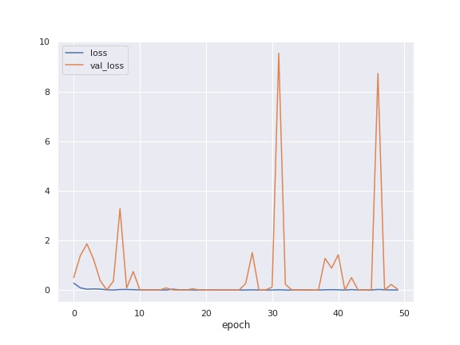
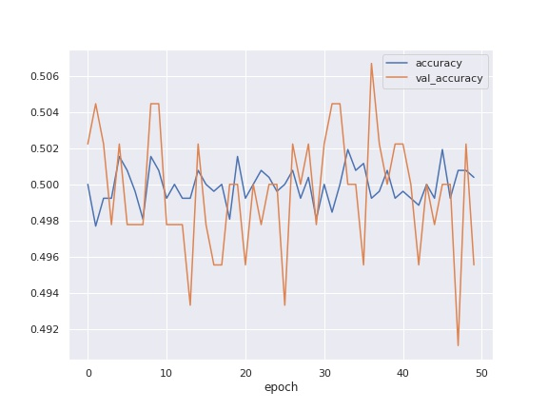
Model: 08-07-2022 20:00 ____________________________________________________________ Layer (type) Output Shape Param # ============================================================ input_1 (InputLayer) [(None, 256, 256, 1)] 0 conv2d (Conv2D) (None, 254, 254, 64) 640 max_pooling2d (MaxPooling2D) (None, 127, 127, 64) 0 batch_normalization (BatchNormalization) (None, 127, 127, 64) 256 conv2d_1 (Conv2D) (None, 125, 125, 64) 36928 max_pooling2d_1 (MaxPooling2D) (None, 62, 62, 64) 0 batch_normalization_1 (BatchNormalization) (None, 62, 62, 64) 256 conv2d_2 (Conv2D) (None, 60, 60, 64) 36928 max_pooling2d_2 (MaxPooling2D) (None, 30, 30, 64) 0 batch_normalization_2 (BatchNormalization) (None, 30, 30, 64) 256 conv2d_3 (Conv2D) (None, 28, 28, 128) 73856 max_pooling2d_3 (MaxPooling2D) (None, 14, 14, 128) 0 batch_normalization_3 (BatchNormalization) (None, 14, 14, 128) 512 conv2d_4 (Conv2D) (None, 12, 12, 256) 295168 max_pooling2d_4 (MaxPooling2D) (None, 6, 6, 256) 0 batch_normalization_4 (BatchNormalization) (None, 6, 6, 256) 1024 conv2d_5 (Conv2D) (None, 4, 4, 256) 590080 max_pooling2d_5 (MaxPooling2D) (None, 2, 2, 256) 0 batch_normalization_5 (BatchNormalization) (None, 2, 2, 256) 1024 global_average_pooling2d (GlobalAveragePooling2D) (None, 256) 0 dense (Dense) (None, 512) 131584 dropout (Dropout) (None, 512) 0 dense_1 (Dense) (None, 1) 513 ============================================================ Total params: 1,169,025 Trainable params: 1,167,361 Non-trainable params: 1,664 ____________________________________________________________ Optimizer: {"name": "Adam", "learning_rate": 0.001, "decay": 0.0, "beta_1": 0.9, "beta_2": 0.999, "epsilon": 1e-07, "amsgrad": false}

Slide 3
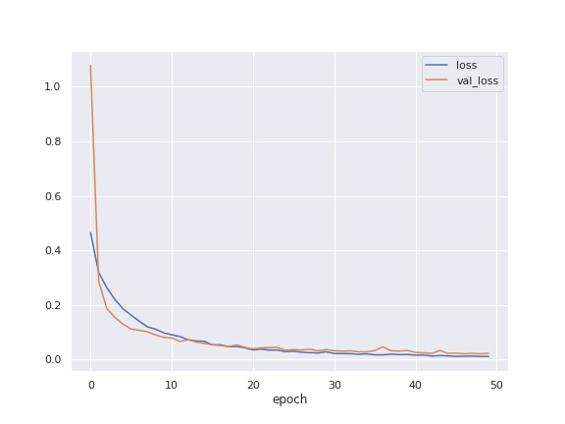
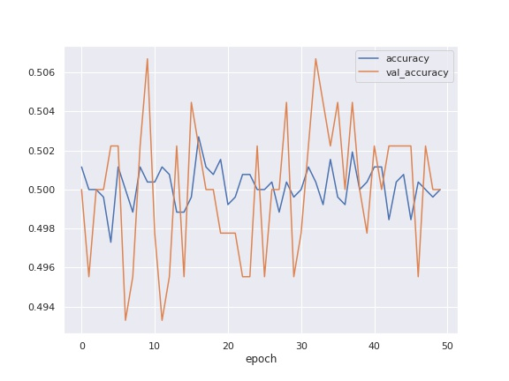
Model: 08-07-2022 20:10 ____________________________________________________________ Layer (type) Output Shape Param # ============================================================ input_1 (InputLayer) [(None, 256, 256, 1)] 0 conv2d (Conv2D) (None, 254, 254, 64) 640 max_pooling2d (MaxPooling2D) (None, 127, 127, 64) 0 batch_normalization (BatchNormalization) (None, 127, 127, 64) 256 conv2d_1 (Conv2D) (None, 125, 125, 64) 36928 max_pooling2d_1 (MaxPooling2D) (None, 62, 62, 64) 0 batch_normalization_1 (BatchNormalization) (None, 62, 62, 64) 256 conv2d_2 (Conv2D) (None, 60, 60, 64) 36928 max_pooling2d_2 (MaxPooling2D) (None, 30, 30, 64) 0 batch_normalization_2 (BatchNormalization) (None, 30, 30, 64) 256 conv2d_3 (Conv2D) (None, 28, 28, 128) 73856 max_pooling2d_3 (MaxPooling2D) (None, 14, 14, 128) 0 batch_normalization_3 (BatchNormalization) (None, 14, 14, 128) 512 conv2d_4 (Conv2D) (None, 12, 12, 256) 295168 max_pooling2d_4 (MaxPooling2D) (None, 6, 6, 256) 0 batch_normalization_4 (BatchNormalization) (None, 6, 6, 256) 1024 conv2d_5 (Conv2D) (None, 4, 4, 256) 590080 max_pooling2d_5 (MaxPooling2D) (None, 2, 2, 256) 0 batch_normalization_5 (BatchNormalization) (None, 2, 2, 256) 1024 global_average_pooling2d (GlobalAveragePooling2D) (None, 256) 0 dense (Dense) (None, 512) 131584 dropout (Dropout) (None, 512) 0 dense_1 (Dense) (None, 1) 513 ============================================================ Total params: 1,169,025 Trainable params: 1,167,361 Non-trainable params: 1,664 ____________________________________________________________ Optimizer: {"name": "Adagrad", "learning_rate": 0.001, "decay": 0.0, "initial_accumulator_value": 0.1, "epsilon": 1e-07}

Slide 4
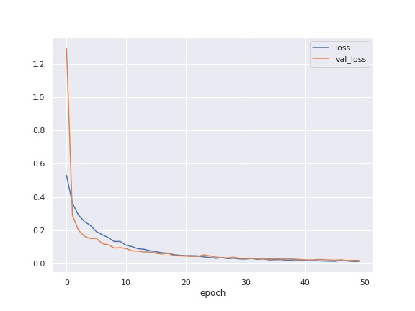
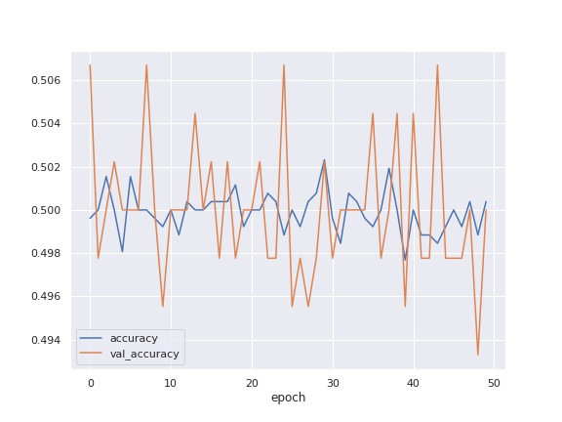
Model: 08-07-2022 20:19 ____________________________________________________________ Layer (type) Output Shape Param # ============================================================ input_1 (InputLayer) [(None, 256, 256, 1)] 0 conv2d_1 (Conv2D) (None, 254, 254, 64) 640 max_pooling2d_1 (MaxPooling2D) (None, 127, 127, 64) 0 batch_normalization_1 (BatchNormalization) (None, 127, 127, 64) 256 conv2d_2 (Conv2D) (None, 125, 125, 64) 36928 max_pooling2d_2 (MaxPooling2D) (None, 62, 62, 64) 0 batch_normalization_2 (BatchNormalization) (None, 62, 62, 64) 256 conv2d_3 (Conv2D) (None, 60, 60, 64) 36928 max_pooling2d_3 (MaxPooling2D) (None, 30, 30, 64) 0 batch_normalization_3 (BatchNormalization) (None, 30, 30, 64) 256 conv2d_4 (Conv2D) (None, 28, 28, 128) 73856 max_pooling2d_4 (MaxPooling2D) (None, 14, 14, 128) 0 batch_normalization_4 (BatchNormalization) (None, 14, 14, 128) 512 conv2d_5 (Conv2D) (None, 12, 12, 256) 295168 max_pooling2d_5 (MaxPooling2D) (None, 6, 6, 256) 0 batch_normalization_5 (BatchNormalization) (None, 6, 6, 256) 1024 conv2d_6 (Conv2D) (None, 4, 4, 256) 590080 max_pooling2d_6 (MaxPooling2D) (None, 2, 2, 256) 0 batch_normalization_6 (BatchNormalization) (None, 2, 2, 256) 1024 global_average_pooling2d (GlobalAveragePooling2D) (None, 256) 0 dense (Dense) (None, 512) 131584 dropout (Dropout) (None, 512) 0 dense_1 (Dense) (None, 1) 513 ============================================================ Total params: 1,169,025 Trainable params: 1,167,361 Non-trainable params: 1,664 ____________________________________________________________ Optimizer: {"name": "Adagrad", "learning_rate": 0.001, "decay": 0.0, "initial_accumulator_value": 0.1, "epsilon": 1e-07}

Slide 5
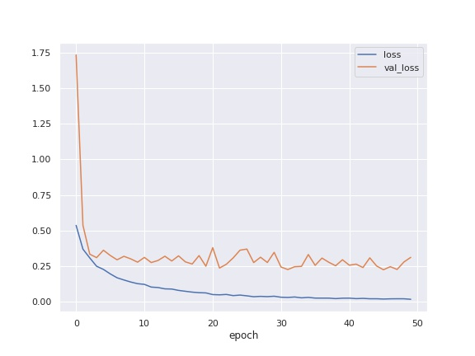
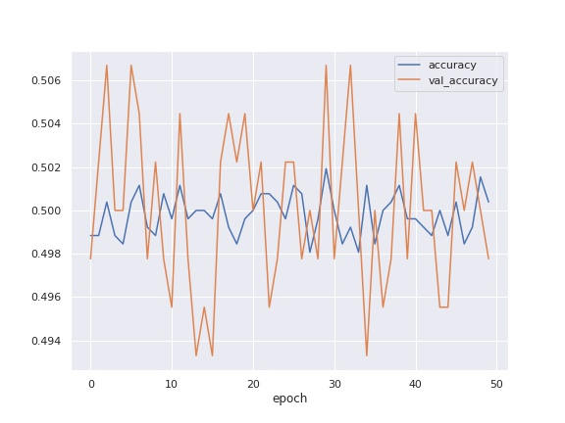
Model: 08-07-2022 20:32 ____________________________________________________________ Layer (type) Output Shape Param # ============================================================ input_1 (InputLayer) [(None, 256, 256, 1)] 0 conv2d (Conv2D) (None, 254, 254, 64) 640 max_pooling2d (MaxPooling2D) (None, 127, 127, 64) 0 batch_normalization (BatchNormalization) (None, 127, 127, 64) 256 conv2d_1 (Conv2D) (None, 125, 125, 64) 36928 max_pooling2d_1 (MaxPooling2D) (None, 62, 62, 64) 0 batch_normalization_1 (BatchNormalization) (None, 62, 62, 64) 256 conv2d_2 (Conv2D) (None, 60, 60, 64) 36928 max_pooling2d_2 (MaxPooling2D) (None, 30, 30, 64) 0 batch_normalization_2 (BatchNormalization) (None, 30, 30, 64) 256 conv2d_3 (Conv2D) (None, 28, 28, 64) 36928 max_pooling2d_3 (MaxPooling2D) (None, 14, 14, 64) 0 batch_normalization_3 (BatchNormalization) (None, 14, 14, 64) 256 conv2d_4 (Conv2D) (None, 12, 12, 128) 73856 max_pooling2d_4 (MaxPooling2D) (None, 6, 6, 128) 0 batch_normalization_4 (BatchNormalization) (None, 6, 6, 128) 512 conv2d_5 (Conv2D) (None, 4, 4, 256) 295168 max_pooling2d_5 (MaxPooling2D) (None, 2, 2, 256) 0 batch_normalization_5 (BatchNormalization) (None, 2, 2, 256) 1024 global_average_pooling2d (GlobalAveragePooling2D) (None, 256) 0 dense (Dense) (None, 512) 131584 dropout (Dropout) (None, 512) 0 dense_1 (Dense) (None, 1) 513 ============================================================ Total params: 615,105 Trainable params: 613,825 Non-trainable params: 1,280 ____________________________________________________________ Optimizer: {"name": "Adagrad", "learning_rate": 0.001, "decay": 0.0, "initial_accumulator_value": 0.1, "epsilon": 1e-07}

Slide 6
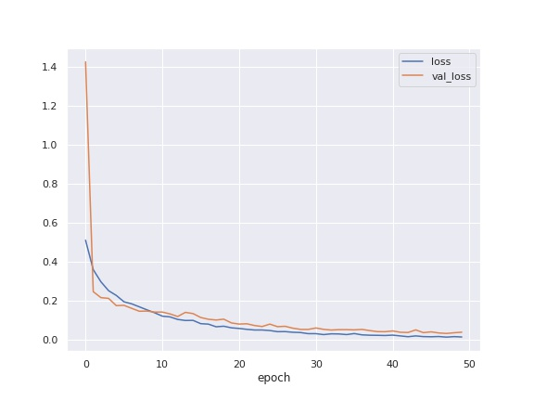
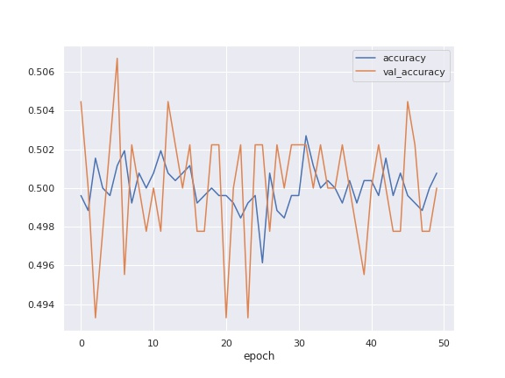
Model: 08-07-2022 20:46 ____________________________________________________________ Layer (type) Output Shape Param # ============================================================ input_1 (InputLayer) [(None, 256, 256, 1)] 0 conv2d_1 (Conv2D) (None, 254, 254, 64) 640 max_pooling2d_1 (MaxPooling2D) (None, 127, 127, 64) 0 batch_normalization_1 (BatchNormalization) (None, 127, 127, 64) 256 conv2d_2 (Conv2D) (None, 125, 125, 64) 36928 max_pooling2d_2 (MaxPooling2D) (None, 62, 62, 64) 0 batch_normalization_2 (BatchNormalization) (None, 62, 62, 64) 256 conv2d_3 (Conv2D) (None, 60, 60, 64) 36928 max_pooling2d_3 (MaxPooling2D) (None, 30, 30, 64) 0 batch_normalization_3 (BatchNormalization) (None, 30, 30, 64) 256 conv2d_4 (Conv2D) (None, 28, 28, 64) 36928 max_pooling2d_4 (MaxPooling2D) (None, 14, 14, 64) 0 batch_normalization_4 (BatchNormalization) (None, 14, 14, 64) 256 conv2d_5 (Conv2D) (None, 12, 12, 128) 73856 max_pooling2d_5 (MaxPooling2D) (None, 6, 6, 128) 0 batch_normalization_5 (BatchNormalization) (None, 6, 6, 128) 512 conv2d_6 (Conv2D) (None, 4, 4, 256) 295168 max_pooling2d_6 (MaxPooling2D) (None, 2, 2, 256) 0 batch_normalization_6 (BatchNormalization) (None, 2, 2, 256) 1024 global_average_pooling2d (GlobalAveragePooling2D) (None, 256) 0 dense (Dense) (None, 512) 131584 dropout (Dropout) (None, 512) 0 dense_1 (Dense) (None, 1) 513 ============================================================ Total params: 615,105 Trainable params: 613,825 Non-trainable params: 1,280 ____________________________________________________________ Optimizer: {"name": "Adagrad", "learning_rate": 0.001, "decay": 0.0, "initial_accumulator_value": 0.1, "epsilon": 1e-07}

Slide 7
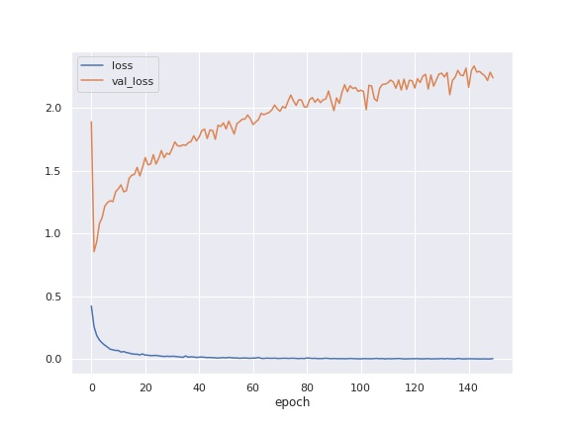
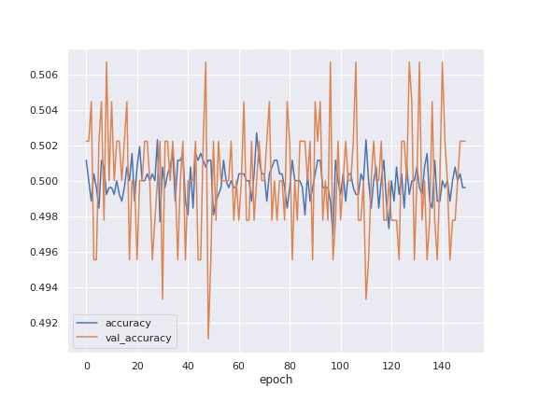
Model: 08-07-2022 20:54 ____________________________________________________________ Layer (type) Output Shape Param # ============================================================ input_1 (InputLayer) [(None, 256, 256, 1)] 0 conv2d_1 (Conv2D) (None, 254, 254, 64) 640 max_pooling2d_1 (MaxPooling2D) (None, 127, 127, 64) 0 batch_normalization_1 (BatchNormalization) (None, 127, 127, 64) 256 conv2d_2 (Conv2D) (None, 125, 125, 64) 36928 max_pooling2d_2 (MaxPooling2D) (None, 62, 62, 64) 0 batch_normalization_2 (BatchNormalization) (None, 62, 62, 64) 256 conv2d_3 (Conv2D) (None, 60, 60, 64) 36928 max_pooling2d_3 (MaxPooling2D) (None, 30, 30, 64) 0 batch_normalization_3 (BatchNormalization) (None, 30, 30, 64) 256 conv2d_4 (Conv2D) (None, 28, 28, 64) 36928 max_pooling2d_4 (MaxPooling2D) (None, 14, 14, 64) 0 batch_normalization_4 (BatchNormalization) (None, 14, 14, 64) 256 conv2d_5 (Conv2D) (None, 12, 12, 128) 73856 max_pooling2d_5 (MaxPooling2D) (None, 6, 6, 128) 0 batch_normalization_5 (BatchNormalization) (None, 6, 6, 128) 512 conv2d_6 (Conv2D) (None, 4, 4, 256) 295168 max_pooling2d_6 (MaxPooling2D) (None, 2, 2, 256) 0 batch_normalization_6 (BatchNormalization) (None, 2, 2, 256) 1024 global_average_pooling2d (GlobalAveragePooling2D) (None, 256) 0 dense (Dense) (None, 512) 131584 dropout (Dropout) (None, 512) 0 dense_1 (Dense) (None, 1) 513 ============================================================ Total params: 615,105 Trainable params: 613,825 Non-trainable params: 1,280 ____________________________________________________________ Optimizer: {"name": "Adagrad", "learning_rate": 0.001, "decay": 0.0, "initial_accumulator_value": 0.1, "epsilon": 1e-07}

Slide 8
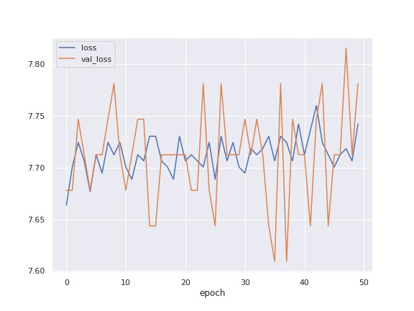
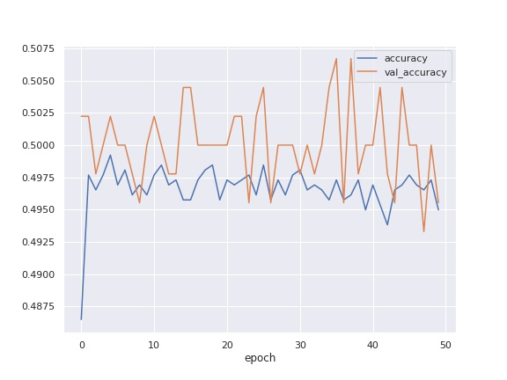
Model: 12-07-2022 15:55 ____________________________________________________________ Layer (type) Output Shape Param # ============================================================ input_1 (InputLayer) [(None, 256, 256, 1)] 0 conv2d (Conv2D) (None, 250, 250, 6) 300 conv2d_1 (Conv2D) (None, 244, 244, 6) 1770 conv2d_2 (Conv2D) (None, 238, 238, 12) 3540 max_pooling2d (MaxPooling2D) (None, 119, 119, 12) 0 conv2d_3 (Conv2D) (None, 115, 115, 12) 3612 conv2d_4 (Conv2D) (None, 111, 111, 32) 9632 max_pooling2d_1 (MaxPooling2D) (None, 55, 55, 32) 0 conv2d_5 (Conv2D) (None, 53, 53, 64) 18496 conv2d_6 (Conv2D) (None, 51, 51, 128) 73856 max_pooling2d_2 (MaxPooling2D) (None, 25, 25, 128) 0 conv2d_7 (Conv2D) (None, 23, 23, 64) 73792 conv2d_8 (Conv2D) (None, 21, 21, 32) 18464 max_pooling2d_3 (MaxPooling2D) (None, 7, 7, 32) 0 max_pooling2d_4 (MaxPooling2D) (None, 3, 3, 32) 0 conv2d_9 (Conv2D) (None, 1, 1, 16) 4624 dense (Dense) (None, 1, 1, 1) 17 flatten (Flatten) (None, 1) 0 ============================================================ Total params: 208,103 Trainable params: 208,103 Non-trainable params: 0 ____________________________________________________________ Optimizer: {"name": "Adagrad", "learning_rate": 0.001, "decay": 0.0, "initial_accumulator_value": 0.1, "epsilon": 1e-07}

Slide 9
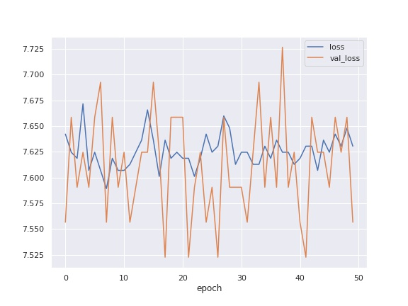
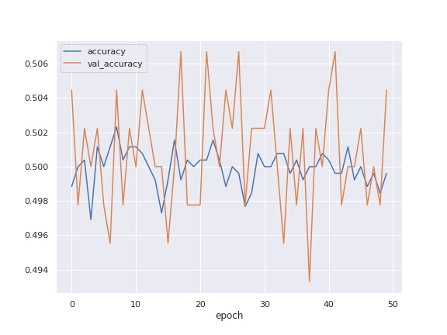
Model: 12-07-2022 16:10 ____________________________________________________________ Layer (type) Output Shape Param # ============================================================ input_1 (InputLayer) [(None, 256, 256, 1)] 0 conv2d (Conv2D) (None, 250, 250, 6) 300 conv2d_1 (Conv2D) (None, 250, 250, 16) 4720 conv2d_2 (Conv2D) (None, 250, 250, 32) 25120 conv2d_3 (Conv2D) (None, 244, 244, 6) 9414 conv2d_4 (Conv2D) (None, 238, 238, 12) 3540 max_pooling2d (MaxPooling2D) (None, 119, 119, 12) 0 conv2d_5 (Conv2D) (None, 115, 115, 12) 3612 conv2d_6 (Conv2D) (None, 111, 111, 32) 9632 max_pooling2d_1 (MaxPooling2D) (None, 55, 55, 32) 0 conv2d_7 (Conv2D) (None, 53, 53, 64) 18496 conv2d_8 (Conv2D) (None, 51, 51, 128) 73856 max_pooling2d_2 (MaxPooling2D) (None, 25, 25, 128) 0 conv2d_9 (Conv2D) (None, 23, 23, 64) 73792 conv2d_10 (Conv2D) (None, 21, 21, 32) 18464 max_pooling2d_3 (MaxPooling2D) (None, 7, 7, 32) 0 max_pooling2d_4 (MaxPooling2D) (None, 3, 3, 32) 0 conv2d_11 (Conv2D) (None, 1, 1, 16) 4624 dense (Dense) (None, 1, 1, 1) 17 flatten (Flatten) (None, 1) 0 ============================================================ Total params: 245,587 Trainable params: 245,587 Non-trainable params: 0 ____________________________________________________________ Optimizer: {"name": "Adagrad", "learning_rate": 0.001, "decay": 0.0, "initial_accumulator_value": 0.1, "epsilon": 1e-07}

Slide 10
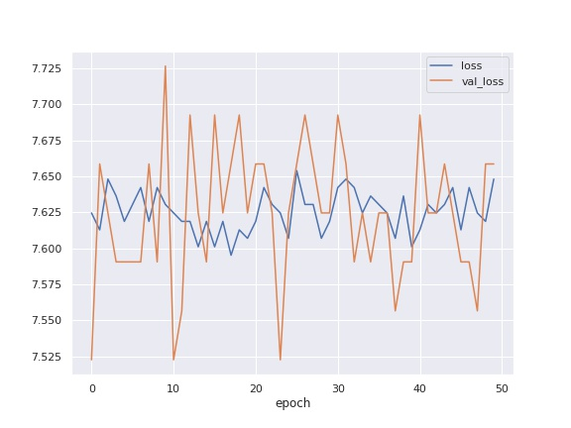
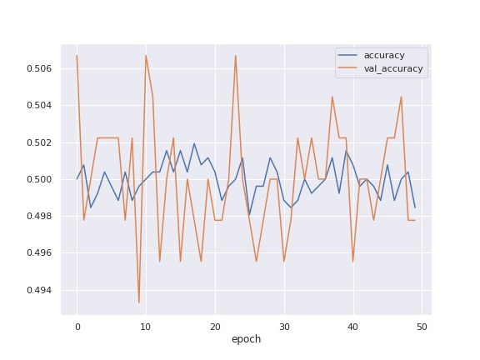
Model: 12-07-2022 16:25 ____________________________________________________________ Layer (type) Output Shape Param # ============================================================ input_1 (InputLayer) [(None, 256, 256, 1)] 0 conv2d (Conv2D) (None, 250, 250, 6) 300 conv2d_1 (Conv2D) (None, 250, 250, 16) 4720 conv2d_2 (Conv2D) (None, 250, 250, 32) 25120 conv2d_3 (Conv2D) (None, 244, 244, 6) 9414 conv2d_4 (Conv2D) (None, 238, 238, 12) 3540 max_pooling2d (MaxPooling2D) (None, 119, 119, 12) 0 conv2d_5 (Conv2D) (None, 115, 115, 12) 3612 conv2d_6 (Conv2D) (None, 111, 111, 32) 9632 max_pooling2d_1 (MaxPooling2D) (None, 55, 55, 32) 0 conv2d_7 (Conv2D) (None, 53, 53, 64) 18496 conv2d_8 (Conv2D) (None, 51, 51, 128) 73856 max_pooling2d_2 (MaxPooling2D) (None, 25, 25, 128) 0 conv2d_9 (Conv2D) (None, 23, 23, 64) 73792 conv2d_10 (Conv2D) (None, 21, 21, 32) 18464 max_pooling2d_3 (MaxPooling2D) (None, 7, 7, 32) 0 max_pooling2d_4 (MaxPooling2D) (None, 3, 3, 32) 0 conv2d_11 (Conv2D) (None, 1, 1, 16) 4624 dense (Dense) (None, 1, 1, 1) 17 flatten (Flatten) (None, 1) 0 ============================================================ Total params: 245,587 Trainable params: 245,587 Non-trainable params: 0 ____________________________________________________________ Optimizer: {"name": "Adam", "learning_rate": 0.001, "decay": 0.0, "beta_1": 0.9, "beta_2": 0.999, "epsilon": 1e-07, "amsgrad": false}

Slide 11
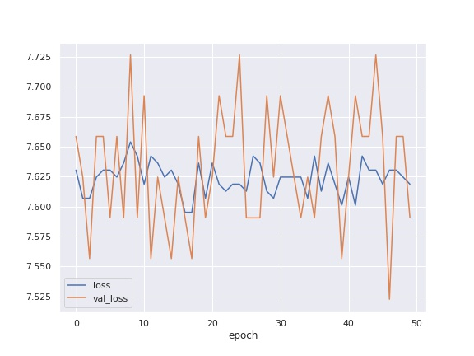
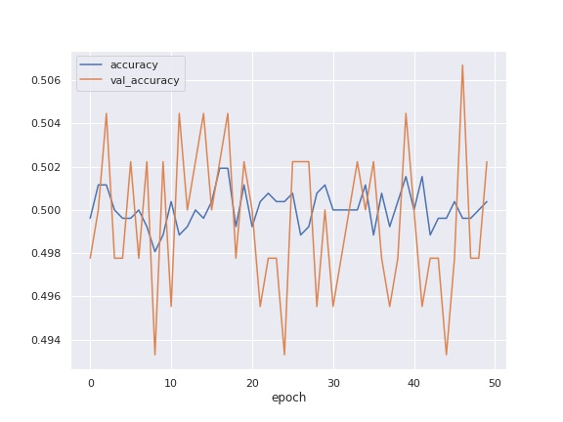
Model: 12-07-2022 16:43 ____________________________________________________________ Layer (type) Output Shape Param # ============================================================ input_1 (InputLayer) [(None, 256, 256, 1)] 0 conv2d (Conv2D) (None, 250, 250, 6) 300 conv2d_1 (Conv2D) (None, 250, 250, 16) 4720 conv2d_2 (Conv2D) (None, 250, 250, 32) 25120 conv2d_3 (Conv2D) (None, 244, 244, 6) 9414 conv2d_4 (Conv2D) (None, 238, 238, 12) 3540 max_pooling2d (MaxPooling2D) (None, 119, 119, 12) 0 conv2d_5 (Conv2D) (None, 115, 115, 12) 3612 conv2d_6 (Conv2D) (None, 111, 111, 32) 9632 conv2d_7 (Conv2D) (None, 111, 111, 12) 9612 conv2d_8 (Conv2D) (None, 111, 111, 32) 9632 max_pooling2d_1 (MaxPooling2D) (None, 55, 55, 32) 0 conv2d_9 (Conv2D) (None, 53, 53, 64) 18496 conv2d_10 (Conv2D) (None, 51, 51, 128) 73856 max_pooling2d_2 (MaxPooling2D) (None, 25, 25, 128) 0 conv2d_11 (Conv2D) (None, 23, 23, 64) 73792 conv2d_12 (Conv2D) (None, 21, 21, 32) 18464 max_pooling2d_3 (MaxPooling2D) (None, 7, 7, 32) 0 max_pooling2d_4 (MaxPooling2D) (None, 3, 3, 32) 0 conv2d_13 (Conv2D) (None, 1, 1, 16) 4624 dense (Dense) (None, 1, 1, 1) 17 flatten (Flatten) (None, 1) 0 ============================================================ Total params: 264,831 Trainable params: 264,831 Non-trainable params: 0 ____________________________________________________________ Optimizer: {"name": "Adam", "learning_rate": 0.001, "decay": 0.0, "beta_1": 0.9, "beta_2": 0.999, "epsilon": 1e-07, "amsgrad": false}

Slide 12
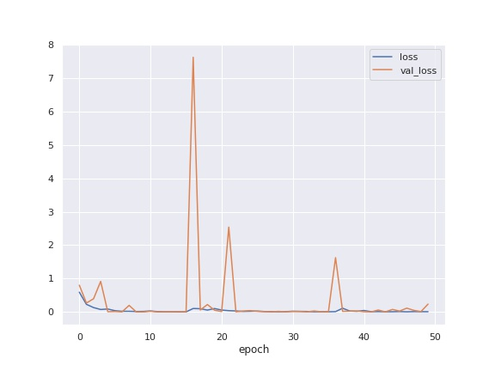
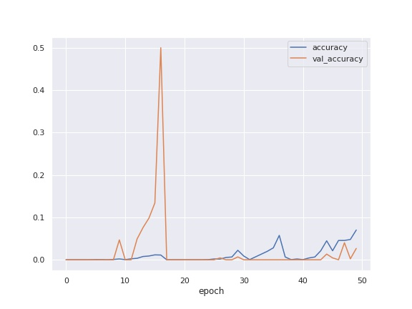
Model: 12-07-2022 17:02 ____________________________________________________________ Layer (type) Output Shape Param # ============================================================ input_1 (InputLayer) [(None, 256, 256, 1)] 0 conv2d (Conv2D) (None, 250, 250, 6) 300 conv2d_1 (Conv2D) (None, 250, 250, 16) 4720 conv2d_2 (Conv2D) (None, 250, 250, 32) 25120 conv2d_3 (Conv2D) (None, 244, 244, 6) 9414 conv2d_4 (Conv2D) (None, 238, 238, 12) 3540 batch_normalization (BatchNormalization) (None, 238, 238, 12) 48 max_pooling2d (MaxPooling2D) (None, 119, 119, 12) 0 conv2d_5 (Conv2D) (None, 115, 115, 12) 3612 conv2d_6 (Conv2D) (None, 111, 111, 32) 9632 conv2d_7 (Conv2D) (None, 111, 111, 12) 9612 conv2d_8 (Conv2D) (None, 111, 111, 32) 9632 batch_normalization_1 (BatchNormalization) (None, 111, 111, 32) 128 max_pooling2d_1 (MaxPooling2D) (None, 55, 55, 32) 0 conv2d_9 (Conv2D) (None, 53, 53, 64) 18496 conv2d_10 (Conv2D) (None, 51, 51, 128) 73856 batch_normalization_2 (BatchNormalization) (None, 51, 51, 128) 512 max_pooling2d_2 (MaxPooling2D) (None, 25, 25, 128) 0 conv2d_11 (Conv2D) (None, 23, 23, 64) 73792 conv2d_12 (Conv2D) (None, 21, 21, 32) 18464 batch_normalization_3 (BatchNormalization) (None, 21, 21, 32) 128 max_pooling2d_3 (MaxPooling2D) (None, 7, 7, 32) 0 max_pooling2d_4 (MaxPooling2D) (None, 3, 3, 32) 0 conv2d_13 (Conv2D) (None, 1, 1, 16) 4624 dense (Dense) (None, 1, 1, 1) 17 flatten (Flatten) (None, 1) 0 ============================================================ Total params: 265,647 Trainable params: 265,239 Non-trainable params: 408 ____________________________________________________________ Optimizer: {"name": "Adam", "learning_rate": 0.001, "decay": 0.0, "beta_1": 0.9, "beta_2": 0.999, "epsilon": 1e-07, "amsgrad": false}

Slide 13
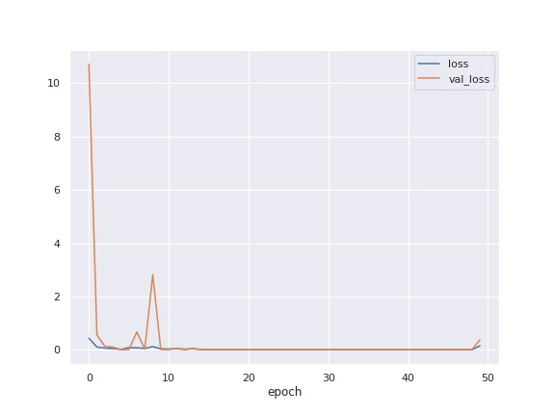
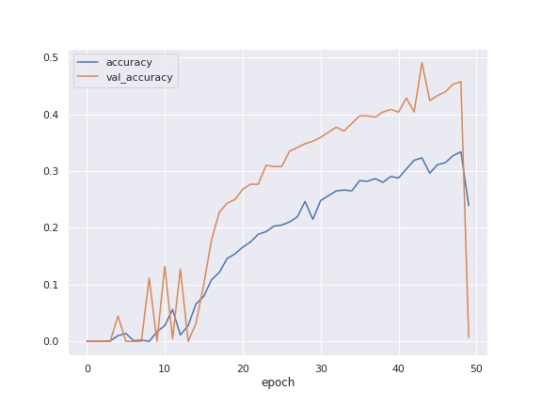
Model: 13-07-2022 15:08 ____________________________________________________________ Layer (type) Output Shape Param # ============================================================ input_1 (InputLayer) [(None, 256, 256, 1)] 0 conv2d (Conv2D) (None, 250, 250, 6) 300 conv2d_1 (Conv2D) (None, 250, 250, 16) 4720 conv2d_2 (Conv2D) (None, 250, 250, 32) 25120 conv2d_3 (Conv2D) (None, 244, 244, 6) 9414 conv2d_4 (Conv2D) (None, 238, 238, 12) 3540 batch_normalization (BatchNormalization) (None, 238, 238, 12) 48 max_pooling2d (MaxPooling2D) (None, 119, 119, 12) 0 conv2d_5 (Conv2D) (None, 115, 115, 12) 3612 conv2d_6 (Conv2D) (None, 111, 111, 32) 9632 conv2d_7 (Conv2D) (None, 111, 111, 12) 9612 conv2d_8 (Conv2D) (None, 111, 111, 32) 9632 batch_normalization_1 (BatchNormalization) (None, 111, 111, 32) 128 max_pooling2d_1 (MaxPooling2D) (None, 55, 55, 32) 0 conv2d_9 (Conv2D) (None, 53, 53, 64) 18496 conv2d_10 (Conv2D) (None, 51, 51, 128) 73856 batch_normalization_2 (BatchNormalization) (None, 51, 51, 128) 512 max_pooling2d_2 (MaxPooling2D) (None, 25, 25, 128) 0 conv2d_11 (Conv2D) (None, 23, 23, 64) 73792 conv2d_12 (Conv2D) (None, 21, 21, 32) 18464 flatten (Flatten) (None, 14112) 0 dense (Dense) (None, 1) 14113 ============================================================ Total params: 274,991 Trainable params: 274,647 Non-trainable params: 344 ____________________________________________________________ Optimizer: {"name": "Adam", "learning_rate": 0.001, "decay": 0.0, "beta_1": 0.9, "beta_2": 0.999, "epsilon": 1e-07, "amsgrad": false}

Slide 14
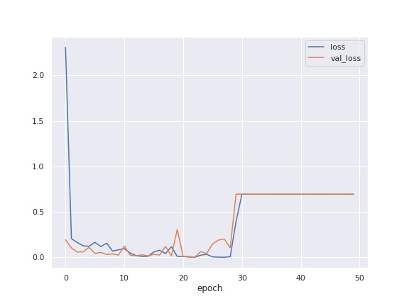
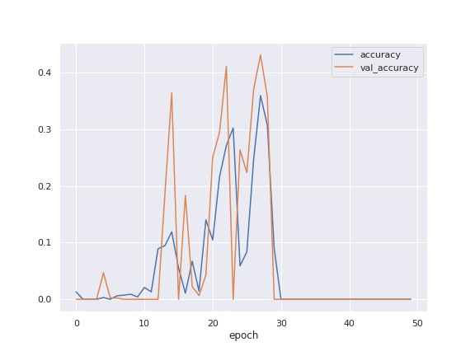
Model: 13-07-2022 15:43 ____________________________________________________________ Layer (type) Output Shape Param # ============================================================ input_1 (InputLayer) [(None, 256, 256, 1)] 0 conv2d (Conv2D) (None, 250, 250, 6) 300 conv2d_1 (Conv2D) (None, 250, 250, 16) 4720 conv2d_2 (Conv2D) (None, 250, 250, 32) 25120 conv2d_3 (Conv2D) (None, 244, 244, 6) 9414 conv2d_4 (Conv2D) (None, 238, 238, 12) 3540 max_pooling2d (MaxPooling2D) (None, 119, 119, 12) 0 conv2d_5 (Conv2D) (None, 115, 115, 12) 3612 conv2d_6 (Conv2D) (None, 111, 111, 32) 9632 conv2d_7 (Conv2D) (None, 111, 111, 12) 9612 conv2d_8 (Conv2D) (None, 111, 111, 32) 9632 max_pooling2d_1 (MaxPooling2D) (None, 55, 55, 32) 0 conv2d_9 (Conv2D) (None, 53, 53, 64) 18496 conv2d_10 (Conv2D) (None, 51, 51, 128) 73856 max_pooling2d_2 (MaxPooling2D) (None, 25, 25, 128) 0 conv2d_11 (Conv2D) (None, 23, 23, 64) 73792 conv2d_12 (Conv2D) (None, 21, 21, 32) 18464 flatten (Flatten) (None, 14112) 0 dense (Dense) (None, 1) 14113 ============================================================ Total params: 274,303 Trainable params: 274,303 Non-trainable params: 0 ____________________________________________________________ Optimizer: {"name": "Adam", "learning_rate": 0.001, "decay": 0.0, "beta_1": 0.9, "beta_2": 0.999, "epsilon": 1e-07, "amsgrad": false}

Slide 15
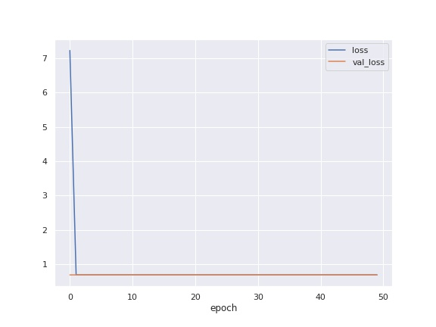
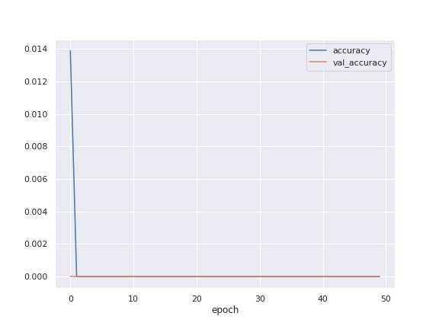
Model: 13-07-2022 16:11 ____________________________________________________________ Layer (type) Output Shape Param # ============================================================ input_1 (InputLayer) [(None, 256, 256, 1)] 0 conv2d (Conv2D) (None, 250, 250, 6) 300 conv2d_1 (Conv2D) (None, 250, 250, 16) 4720 conv2d_2 (Conv2D) (None, 250, 250, 32) 25120 conv2d_3 (Conv2D) (None, 244, 244, 6) 9414 conv2d_4 (Conv2D) (None, 238, 238, 12) 3540 max_pooling2d (MaxPooling2D) (None, 119, 119, 12) 0 conv2d_5 (Conv2D) (None, 115, 115, 12) 3612 conv2d_6 (Conv2D) (None, 111, 111, 32) 9632 conv2d_7 (Conv2D) (None, 111, 111, 12) 9612 conv2d_8 (Conv2D) (None, 111, 111, 32) 9632 max_pooling2d_1 (MaxPooling2D) (None, 55, 55, 32) 0 conv2d_9 (Conv2D) (None, 53, 53, 64) 18496 conv2d_10 (Conv2D) (None, 51, 51, 128) 73856 max_pooling2d_2 (MaxPooling2D) (None, 25, 25, 128) 0 conv2d_11 (Conv2D) (None, 23, 23, 64) 73792 flatten (Flatten) (None, 33856) 0 dense (Dense) (None, 1) 33857 ============================================================ Total params: 275,583 Trainable params: 275,583 Non-trainable params: 0 ____________________________________________________________ Optimizer: {"name": "Adam", "learning_rate": 0.001, "decay": 0.0, "beta_1": 0.9, "beta_2": 0.999, "epsilon": 1e-07, "amsgrad": false}

Slide 16
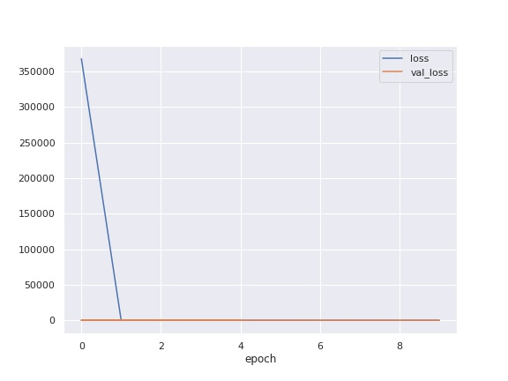
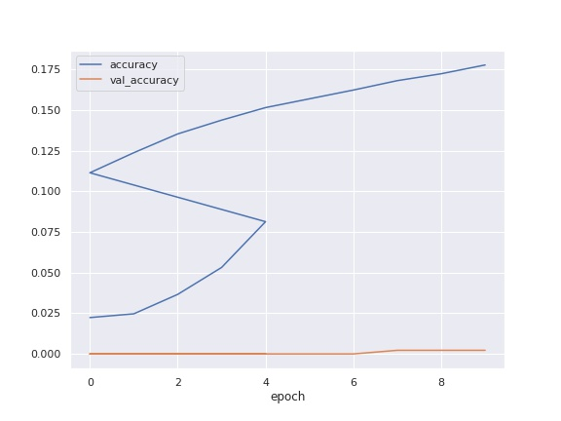
Model: 13-07-2022 16:30 ____________________________________________________________ Layer (type) Output Shape Param # ============================================================ input_1 (InputLayer) [(None, 256, 256, 1)] 0 conv2d (Conv2D) (None, 250, 250, 256) 12800 max_pooling2d (MaxPooling2D) (None, 125, 125, 256) 0 flatten (Flatten) (None, 4000000) 0 dense (Dense) (None, 1) 4000001 ============================================================ Total params: 4,012,801 Trainable params: 4,012,801 Non-trainable params: 0 ____________________________________________________________ Optimizer: {"name": "SGD", "learning_rate": 0.01, "decay": 0.0, "momentum": 0.0, "nesterov": false}

Slide 17
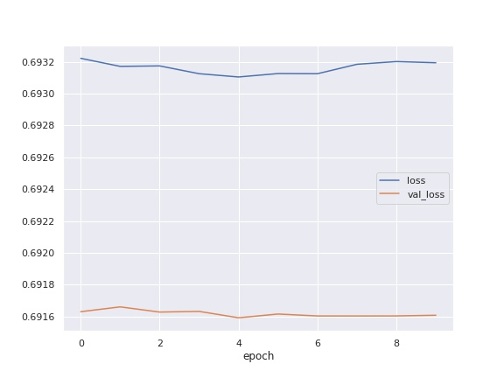
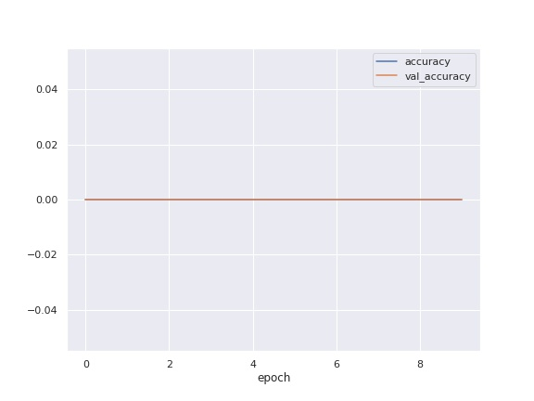
Model: 13-07-2022 16:35 ____________________________________________________________ Layer (type) Output Shape Param # ============================================================ input_1 (InputLayer) [(None, 256, 256, 1)] 0 conv2d (Conv2D) (None, 250, 250, 256) 12800 conv2d_1 (Conv2D) (None, 244, 244, 128) 1605760 max_pooling2d (MaxPooling2D) (None, 122, 122, 128) 0 flatten (Flatten) (None, 1905152) 0 dense (Dense) (None, 1) 1905153 ============================================================ Total params: 3,523,713 Trainable params: 3,523,713 Non-trainable params: 0 ____________________________________________________________ Optimizer: {"name": "SGD", "learning_rate": 0.01, "decay": 0.0, "momentum": 0.0, "nesterov": false}

Slide 18
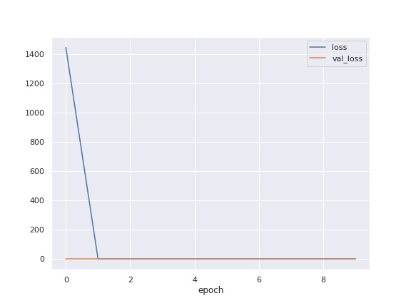
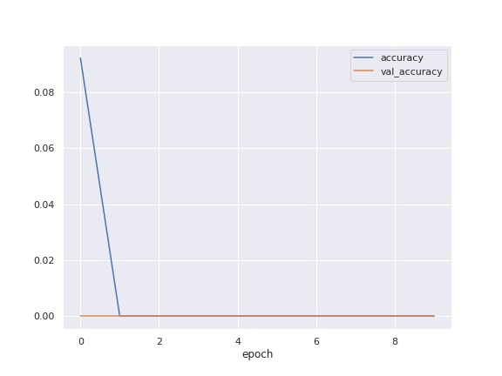
Model: 13-07-2022 17:28 ____________________________________________________________ Layer (type) Output Shape Param # ============================================================ input_1 (InputLayer) [(None, 256, 256, 1)] 0 conv2d (Conv2D) (None, 250, 250, 256) 12800 conv2d_1 (Conv2D) (None, 244, 244, 128) 1605760 max_pooling2d (MaxPooling2D) (None, 122, 122, 128) 0 conv2d_2 (Conv2D) (None, 118, 118, 64) 204864 flatten (Flatten) (None, 891136) 0 dense (Dense) (None, 1) 891137 ============================================================ Total params: 2,714,561 Trainable params: 2,714,561 Non-trainable params: 0 ____________________________________________________________ Optimizer: {"name": "Adam", "learning_rate": 0.001, "decay": 0.0, "beta_1": 0.9, "beta_2": 0.999, "epsilon": 1e-07, "amsgrad": false}

Slide 19
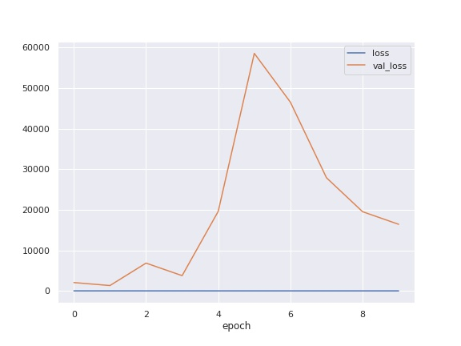
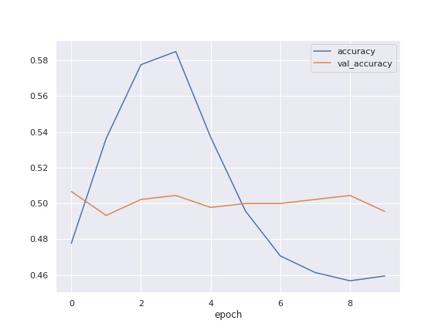
Model: 13-07-2022 18:05 ____________________________________________________________ Layer (type) Output Shape Param # ============================================================ input_1 (InputLayer) [(None, 256, 256, 1)] 0 conv2d (Conv2D) (None, 250, 250, 256) 12800 conv2d_1 (Conv2D) (None, 244, 244, 128) 1605760 max_pooling2d (MaxPooling2D) (None, 122, 122, 128) 0 conv2d_2 (Conv2D) (None, 118, 118, 64) 204864 flatten (Flatten) (None, 891136) 0 batch_normalization (BatchNormalization) (None, 891136) 3564544 dense (Dense) (None, 1) 891137 ============================================================ Total params: 6,279,105 Trainable params: 4,496,833 Non-trainable params: 1,782,272 ____________________________________________________________ Optimizer: {"name": "Adam", "learning_rate": 0.001, "decay": 0.0, "beta_1": 0.9, "beta_2": 0.999, "epsilon": 1e-07, "amsgrad": false}

Slide 20
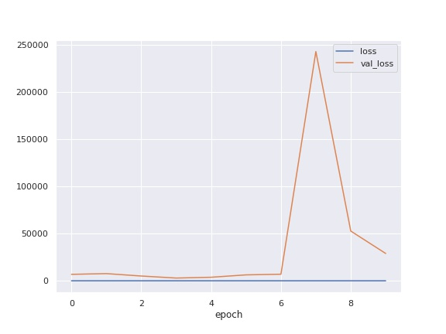
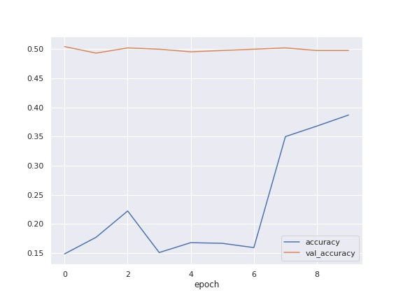
Model: 13-07-2022 20:14 ____________________________________________________________ Layer (type) Output Shape Param # ============================================================ input_1 (InputLayer) [(None, 256, 256, 1)] 0 conv2d (Conv2D) (None, 250, 250, 256) 12800 conv2d_1 (Conv2D) (None, 244, 244, 128) 1605760 max_pooling2d (MaxPooling2D) (None, 122, 122, 128) 0 conv2d_2 (Conv2D) (None, 118, 118, 64) 204864 conv2d_3 (Conv2D) (None, 57, 57, 64) 102464 flatten (Flatten) (None, 207936) 0 batch_normalization (BatchNormalization) (None, 207936) 831744 dense (Dense) (None, 1) 207937 ============================================================ Total params: 2,965,569 Trainable params: 2,549,697 Non-trainable params: 415,872 ____________________________________________________________ Optimizer: {"name": "Adam", "learning_rate": 0.001, "decay": 0.0, "beta_1": 0.9, "beta_2": 0.999, "epsilon": 1e-07, "amsgrad": false}

Slide 21
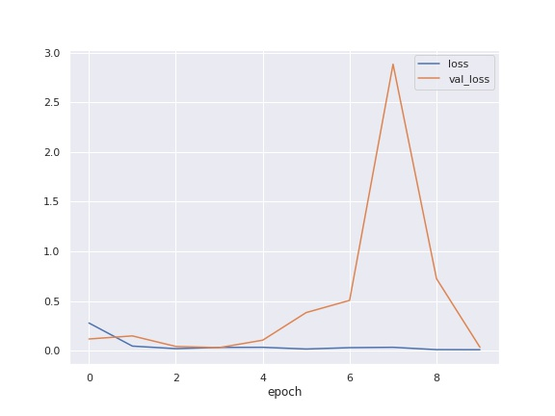
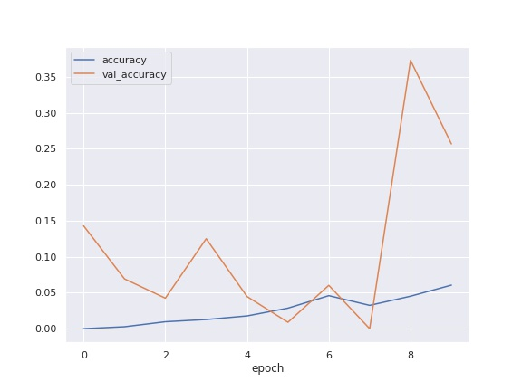
Model: 13-07-2022 20:58 ____________________________________________________________ Layer (type) Output Shape Param # ============================================================ input_1 (InputLayer) [(None, 256, 256, 1)] 0 conv2d (Conv2D) (None, 250, 250, 32) 1600 conv2d_1 (Conv2D) (None, 244, 244, 16) 25104 max_pooling2d (MaxPooling2D) (None, 122, 122, 16) 0 conv2d_2 (Conv2D) (None, 118, 118, 8) 3208 conv2d_3 (Conv2D) (None, 57, 57, 4) 804 flatten (Flatten) (None, 12996) 0 batch_normalization (BatchNormalization) (None, 12996) 51984 dense (Dense) (None, 1) 12997 ============================================================ Total params: 95,697 Trainable params: 69,705 Non-trainable params: 25,992 ____________________________________________________________ Optimizer: {"name": "Adam", "learning_rate": 0.001, "decay": 0.0, "beta_1": 0.9, "beta_2": 0.999, "epsilon": 1e-07, "amsgrad": false}

Slide 22
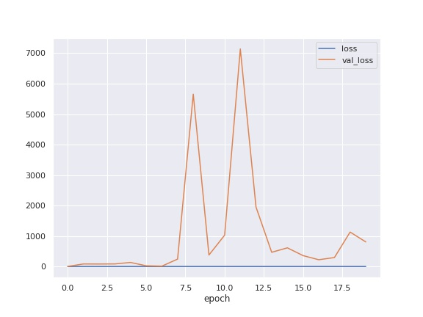
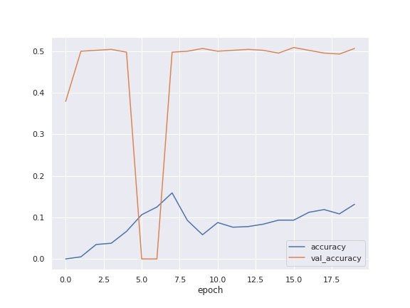
Model: 13-07-2022 21:00 ____________________________________________________________ Layer (type) Output Shape Param # ============================================================ input_1 (InputLayer) [(None, 256, 256, 1)] 0 conv2d (Conv2D) (None, 250, 250, 64) 3200 conv2d_1 (Conv2D) (None, 244, 244, 32) 100384 max_pooling2d (MaxPooling2D) (None, 122, 122, 32) 0 conv2d_2 (Conv2D) (None, 118, 118, 16) 12816 conv2d_3 (Conv2D) (None, 57, 57, 8) 3208 flatten (Flatten) (None, 25992) 0 batch_normalization (BatchNormalization) (None, 25992) 103968 dense (Dense) (None, 1) 25993 ============================================================ Total params: 249,569 Trainable params: 197,585 Non-trainable params: 51,984 ____________________________________________________________ Optimizer: {"name": "Adam", "learning_rate": 0.001, "decay": 0.0, "beta_1": 0.9, "beta_2": 0.999, "epsilon": 1e-07, "amsgrad": false}

Slide 23
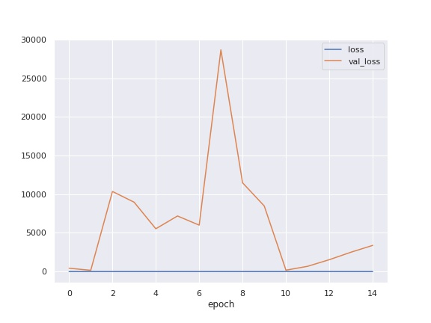
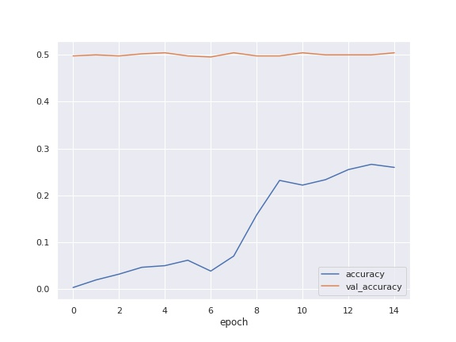
Model: 13-07-2022 21:06 ____________________________________________________________ Layer (type) Output Shape Param # ============================================================ input_1 (InputLayer) [(None, 256, 256, 1)] 0 conv2d (Conv2D) (None, 250, 250, 128) 6400 conv2d_1 (Conv2D) (None, 244, 244, 64) 401472 max_pooling2d (MaxPooling2D) (None, 122, 122, 64) 0 conv2d_2 (Conv2D) (None, 118, 118, 32) 51232 conv2d_3 (Conv2D) (None, 57, 57, 16) 12816 flatten (Flatten) (None, 51984) 0 batch_normalization (BatchNormalization) (None, 51984) 207936 dense (Dense) (None, 1) 51985 ============================================================ Total params: 731,841 Trainable params: 627,873 Non-trainable params: 103,968 ____________________________________________________________ Optimizer: {"name": "Adam", "learning_rate": 0.001, "decay": 0.0, "beta_1": 0.9, "beta_2": 0.999, "epsilon": 1e-07, "amsgrad": false}

Slide 24
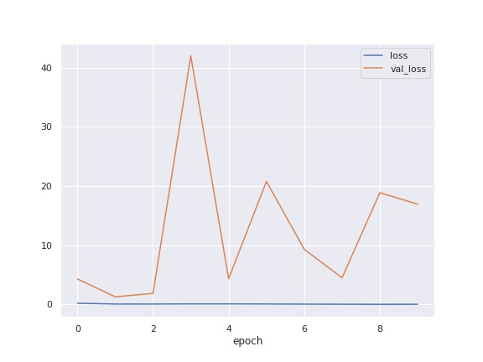
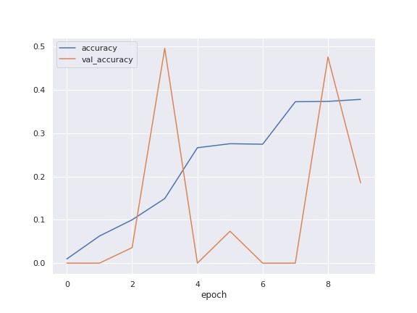
Model: 13-07-2022 21:25 ____________________________________________________________ Layer (type) Output Shape Param # ============================================================ input_1 (InputLayer) [(None, 256, 256, 1)] 0 conv2d (Conv2D) (None, 250, 250, 64) 3200 conv2d_1 (Conv2D) (None, 244, 244, 32) 100384 batch_normalization (BatchNormalization) (None, 244, 244, 32) 128 max_pooling2d (MaxPooling2D) (None, 122, 122, 32) 0 conv2d_2 (Conv2D) (None, 118, 118, 16) 12816 conv2d_3 (Conv2D) (None, 57, 57, 8) 3208 flatten (Flatten) (None, 25992) 0 batch_normalization_1 (BatchNormalization) (None, 25992) 103968 dense (Dense) (None, 1) 25993 ============================================================ Total params: 249,697 Trainable params: 197,649 Non-trainable params: 52,048 ____________________________________________________________ Optimizer: {"name": "Adam", "learning_rate": 0.001, "decay": 0.0, "beta_1": 0.9, "beta_2": 0.999, "epsilon": 1e-07, "amsgrad": false}

Slide 25
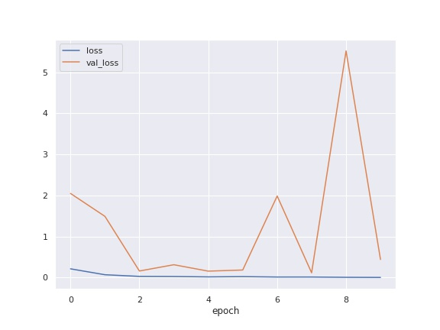
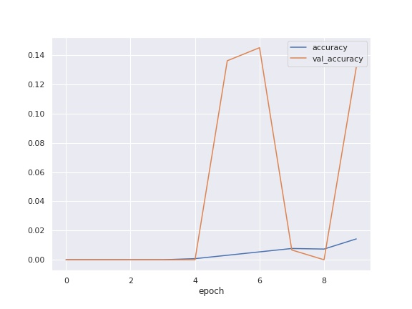
Model: 13-07-2022 21:29 ____________________________________________________________ Layer (type) Output Shape Param # ============================================================ input_1 (InputLayer) [(None, 256, 256, 1)] 0 conv2d (Conv2D) (None, 250, 250, 64) 3200 conv2d_1 (Conv2D) (None, 244, 244, 32) 100384 batch_normalization (BatchNormalization) (None, 244, 244, 32) 128 max_pooling2d (MaxPooling2D) (None, 122, 122, 32) 0 conv2d_2 (Conv2D) (None, 118, 118, 16) 12816 conv2d_3 (Conv2D) (None, 57, 57, 8) 3208 max_pooling2d_1 (MaxPooling2D) (None, 28, 28, 8) 0 flatten (Flatten) (None, 6272) 0 batch_normalization_1 (BatchNormalization) (None, 6272) 25088 dense (Dense) (None, 1) 6273 ============================================================ Total params: 151,097 Trainable params: 138,489 Non-trainable params: 12,608 ____________________________________________________________ Optimizer: {"name": "Adam", "learning_rate": 0.001, "decay": 0.0, "beta_1": 0.9, "beta_2": 0.999, "epsilon": 1e-07, "amsgrad": false}

Slide 26
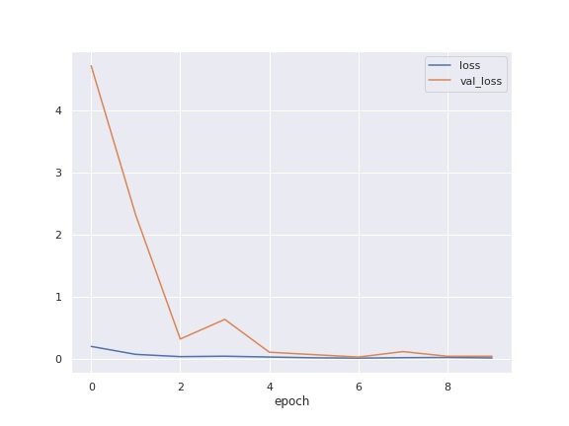
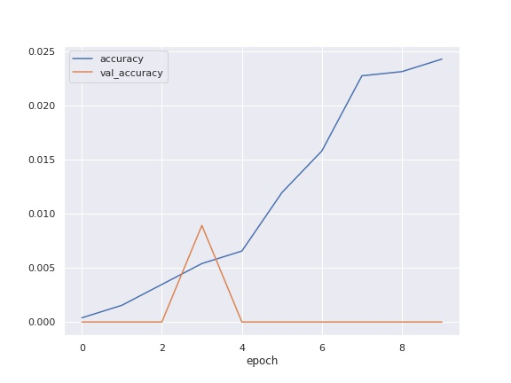
Model: 13-07-2022 21:32 ____________________________________________________________ Layer (type) Output Shape Param # ============================================================ input_1 (InputLayer) [(None, 256, 256, 1)] 0 conv2d (Conv2D) (None, 250, 250, 64) 3200 conv2d_1 (Conv2D) (None, 244, 244, 32) 100384 batch_normalization (BatchNormalization) (None, 244, 244, 32) 128 max_pooling2d (MaxPooling2D) (None, 122, 122, 32) 0 conv2d_2 (Conv2D) (None, 118, 118, 16) 12816 conv2d_3 (Conv2D) (None, 57, 57, 8) 3208 batch_normalization_1 (BatchNormalization) (None, 57, 57, 8) 32 max_pooling2d_1 (MaxPooling2D) (None, 28, 28, 8) 0 flatten (Flatten) (None, 6272) 0 batch_normalization_2 (BatchNormalization) (None, 6272) 25088 dense (Dense) (None, 1) 6273 ============================================================ Total params: 151,129 Trainable params: 138,505 Non-trainable params: 12,624 ____________________________________________________________ Optimizer: {"name": "Adam", "learning_rate": 0.001, "decay": 0.0, "beta_1": 0.9, "beta_2": 0.999, "epsilon": 1e-07, "amsgrad": false}

Slide 27


Model: 13-07-2022 21:36 ____________________________________________________________ Layer (type) Output Shape Param # ============================================================ input_1 (InputLayer) [(None, 256, 256, 1)] 0 conv2d (Conv2D) (None, 250, 250, 64) 3200 conv2d_1 (Conv2D) (None, 244, 244, 32) 100384 max_pooling2d (MaxPooling2D) (None, 122, 122, 32) 0 conv2d_2 (Conv2D) (None, 118, 118, 16) 12816 conv2d_3 (Conv2D) (None, 57, 57, 8) 3208 max_pooling2d_1 (MaxPooling2D) (None, 28, 28, 8) 0 flatten (Flatten) (None, 6272) 0 dense (Dense) (None, 1) 6273 ============================================================ Total params: 125,881 Trainable params: 125,881 Non-trainable params: 0 ____________________________________________________________ Optimizer: {"name": "Adam", "learning_rate": 0.001, "decay": 0.0, "beta_1": 0.9, "beta_2": 0.999, "epsilon": 1e-07, "amsgrad": false}

Slide 28


Model: 14-07-2022 08:12 ____________________________________________________________ Layer (type) Output Shape Param # ============================================================ input_1 (InputLayer) [(None, 256, 256, 1)] 0 conv2d (Conv2D) (None, 250, 250, 64) 3200 conv2d_1 (Conv2D) (None, 244, 244, 32) 100384 max_pooling2d (MaxPooling2D) (None, 122, 122, 32) 0 conv2d_2 (Conv2D) (None, 118, 118, 16) 12816 conv2d_3 (Conv2D) (None, 57, 57, 8) 3208 max_pooling2d_1 (MaxPooling2D) (None, 28, 28, 8) 0 conv2d_4 (Conv2D) (None, 26, 26, 4) 292 conv2d_5 (Conv2D) (None, 24, 24, 4) 148 flatten (Flatten) (None, 2304) 0 dense (Dense) (None, 1) 2305 ============================================================ Total params: 122,353 Trainable params: 122,353 Non-trainable params: 0 ____________________________________________________________ Optimizer: {"name": "Adam", "learning_rate": 0.001, "decay": 0.0, "beta_1": 0.9, "beta_2": 0.999, "epsilon": 1e-07, "amsgrad": false}

Slide 29


Model: 14-07-2022 08:49 ____________________________________________________________ Layer (type) Output Shape Param # ============================================================ input_1 (InputLayer) [(None, 256, 256, 1)] 0 conv2d (Conv2D) (None, 250, 250, 64) 3200 conv2d_1 (Conv2D) (None, 244, 244, 32) 100384 max_pooling2d (MaxPooling2D) (None, 122, 122, 32) 0 conv2d_2 (Conv2D) (None, 118, 118, 16) 12816 conv2d_3 (Conv2D) (None, 57, 57, 8) 3208 max_pooling2d_1 (MaxPooling2D) (None, 28, 28, 8) 0 conv2d_4 (Conv2D) (None, 26, 26, 4) 292 conv2d_5 (Conv2D) (None, 24, 24, 4) 148 average_pooling2d (AveragePooling2D) (None, 12, 12, 4) 0 flatten (Flatten) (None, 576) 0 dense (Dense) (None, 1) 577 ============================================================ Total params: 120,625 Trainable params: 120,625 Non-trainable params: 0 ____________________________________________________________ Optimizer: {"name": "Adam", "learning_rate": 0.001, "decay": 0.0, "beta_1": 0.9, "beta_2": 0.999, "epsilon": 1e-07, "amsgrad": false}

Slide 30


Model: 14-07-2022 08:53 ____________________________________________________________ Layer (type) Output Shape Param # ============================================================ input_1 (InputLayer) [(None, 256, 256, 1)] 0 conv2d (Conv2D) (None, 250, 250, 64) 3200 conv2d_1 (Conv2D) (None, 244, 244, 32) 100384 max_pooling2d (MaxPooling2D) (None, 122, 122, 32) 0 conv2d_2 (Conv2D) (None, 118, 118, 16) 12816 conv2d_3 (Conv2D) (None, 57, 57, 8) 3208 max_pooling2d_1 (MaxPooling2D) (None, 28, 28, 8) 0 conv2d_4 (Conv2D) (None, 26, 26, 4) 292 conv2d_5 (Conv2D) (None, 24, 24, 4) 148 max_pooling2d_2 (MaxPooling2D) (None, 12, 12, 4) 0 flatten (Flatten) (None, 576) 0 dense (Dense) (None, 1) 577 ============================================================ Total params: 120,625 Trainable params: 120,625 Non-trainable params: 0 ____________________________________________________________ Optimizer: {"name": "Adam", "learning_rate": 0.001, "decay": 0.0, "beta_1": 0.9, "beta_2": 0.999, "epsilon": 1e-07, "amsgrad": false}

Slide 31


Model: 14-07-2022 09:00 ____________________________________________________________ Layer (type) Output Shape Param # ============================================================ input_1 (InputLayer) [(None, 256, 256, 1)] 0 conv2d (Conv2D) (None, 250, 250, 64) 3200 conv2d_1 (Conv2D) (None, 244, 244, 32) 100384 max_pooling2d (MaxPooling2D) (None, 122, 122, 32) 0 conv2d_2 (Conv2D) (None, 118, 118, 16) 12816 conv2d_3 (Conv2D) (None, 57, 57, 8) 3208 max_pooling2d_1 (MaxPooling2D) (None, 28, 28, 8) 0 conv2d_4 (Conv2D) (None, 26, 26, 4) 292 conv2d_5 (Conv2D) (None, 24, 24, 4) 148 max_pooling2d_2 (MaxPooling2D) (None, 12, 12, 4) 0 flatten (Flatten) (None, 576) 0 dense (Dense) (None, 1) 577 ============================================================ Total params: 120,625 Trainable params: 120,625 Non-trainable params: 0 ____________________________________________________________ Optimizer: {"name": "Adam", "learning_rate": 0.001, "decay": 0.0, "beta_1": 0.9, "beta_2": 0.999, "epsilon": 1e-07, "amsgrad": false}

Slide 32


Model: 14-07-2022 09:21 ____________________________________________________________ Layer (type) Output Shape Param # ============================================================ input_1 (InputLayer) [(None, 256, 256, 1)] 0 conv2d (Conv2D) (None, 252, 252, 96) 2496 max_pooling2d (MaxPooling2D) (None, 126, 126, 96) 0 conv2d_1 (Conv2D) (None, 122, 122, 256) 614656 max_pooling2d_1 (MaxPooling2D) (None, 61, 61, 256) 0 conv2d_2 (Conv2D) (None, 57, 57, 384) 2457984 max_pooling2d_2 (MaxPooling2D) (None, 28, 28, 384) 0 dense (Dense) (None, 28, 28, 2048) 788480 dense_1 (Dense) (None, 28, 28, 2048) 4196352 dropout (Dropout) (None, 28, 28, 2048) 0 flatten (Flatten) (None, 1605632) 0 dense_2 (Dense) (None, 1) 1605633 ============================================================ Total params: 9,665,601 Trainable params: 9,665,601 Non-trainable params: 0 ____________________________________________________________ Optimizer: {"name": "Adam", "learning_rate": 0.001, "decay": 0.0, "beta_1": 0.9, "beta_2": 0.999, "epsilon": 1e-07, "amsgrad": false}

Slide 33


Model: 14-07-2022 10:05 ____________________________________________________________ Layer (type) Output Shape Param # ============================================================ input_1 (InputLayer) [(None, 256, 256, 1)] 0 conv2d (Conv2D) (None, 252, 252, 96) 2496 max_pooling2d (MaxPooling2D) (None, 126, 126, 96) 0 conv2d_1 (Conv2D) (None, 122, 122, 256) 614656 max_pooling2d_1 (MaxPooling2D) (None, 61, 61, 256) 0 conv2d_2 (Conv2D) (None, 57, 57, 384) 2457984 max_pooling2d_2 (MaxPooling2D) (None, 28, 28, 384) 0 dense (Dense) (None, 28, 28, 2048) 788480 dense_1 (Dense) (None, 28, 28, 2048) 4196352 dropout (Dropout) (None, 28, 28, 2048) 0 flatten (Flatten) (None, 1605632) 0 dense_2 (Dense) (None, 1) 1605633 ============================================================ Total params: 9,665,601 Trainable params: 9,665,601 Non-trainable params: 0 ____________________________________________________________ Optimizer: {"name": "Adam", "learning_rate": 0.001, "decay": 0.0, "beta_1": 0.9, "beta_2": 0.999, "epsilon": 1e-07, "amsgrad": false}

Slide 34


Model: 14-07-2022 10:24 ____________________________________________________________ Layer (type) Output Shape Param # ============================================================ input_1 (InputLayer) [(None, 256, 256, 1)] 0 conv2d (Conv2D) (None, 252, 252, 4) 104 max_pooling2d (MaxPooling2D) (None, 126, 126, 4) 0 conv2d_1 (Conv2D) (None, 122, 122, 8) 808 max_pooling2d_1 (MaxPooling2D) (None, 61, 61, 8) 0 conv2d_2 (Conv2D) (None, 57, 57, 16) 3216 max_pooling2d_2 (MaxPooling2D) (None, 28, 28, 16) 0 dense (Dense) (None, 28, 28, 32) 544 dense_1 (Dense) (None, 28, 28, 32) 1056 dropout (Dropout) (None, 28, 28, 32) 0 flatten (Flatten) (None, 25088) 0 dense_2 (Dense) (None, 1) 25089 ============================================================ Total params: 30,817 Trainable params: 30,817 Non-trainable params: 0 ____________________________________________________________ Optimizer: {"name": "Adam", "learning_rate": 0.001, "decay": 0.0, "beta_1": 0.9, "beta_2": 0.999, "epsilon": 1e-07, "amsgrad": false}

Slide 35


Model: 14-07-2022 15:24 ____________________________________________________________ Layer (type) Output Shape Param # ============================================================ input_1 (InputLayer) [(None, 256, 256, 1)] 0 conv2d (Conv2D) (None, 252, 252, 16) 416 conv2d_1 (Conv2D) (None, 250, 250, 16) 2320 average_pooling2d (AveragePooling2D) (None, 125, 125, 16) 0 flatten (Flatten) (None, 250000) 0 dense (Dense) (None, 1) 250001 ============================================================ Total params: 252,737 Trainable params: 252,737 Non-trainable params: 0 ____________________________________________________________ Optimizer: {"name": "Adam", "learning_rate": 0.001, "decay": 0.0, "beta_1": 0.9, "beta_2": 0.999, "epsilon": 1e-07, "amsgrad": false}

Slide 36


Model: 14-07-2022 15:46 ____________________________________________________________ Layer (type) Output Shape Param # ============================================================ input_1 (InputLayer) [(None, 256, 256, 1)] 0 conv2d (Conv2D) (None, 252, 252, 16) 416 conv2d_1 (Conv2D) (None, 250, 250, 16) 2320 average_pooling2d (AveragePooling2D) (None, 83, 83, 16) 0 flatten (Flatten) (None, 110224) 0 dense (Dense) (None, 1) 110225 ============================================================ Total params: 112,961 Trainable params: 112,961 Non-trainable params: 0 ____________________________________________________________ Optimizer: {"name": "Adam", "learning_rate": 0.001, "decay": 0.0, "beta_1": 0.9, "beta_2": 0.999, "epsilon": 1e-07, "amsgrad": false}

Slide 37


Model: 14-07-2022 15:50 ____________________________________________________________ Layer (type) Output Shape Param # ============================================================ input_1 (InputLayer) [(None, 256, 256, 1)] 0 conv2d_2 (Conv2D) (None, 252, 252, 16) 416 conv2d_3 (Conv2D) (None, 250, 250, 16) 2320 average_pooling2d_1 (AveragePooling2D) (None, 83, 83, 16) 0 flatten (Flatten) (None, 110224) 0 dense (Dense) (None, 1) 110225 ============================================================ Total params: 112,961 Trainable params: 112,961 Non-trainable params: 0 ____________________________________________________________ Optimizer: {"name": "Adam", "learning_rate": 0.001, "decay": 0.0, "beta_1": 0.9, "beta_2": 0.999, "epsilon": 1e-07, "amsgrad": false}

Slide 38


Model: 14-07-2022 15:53 ____________________________________________________________ Layer (type) Output Shape Param # ============================================================ input_1 (InputLayer) [(None, 256, 256, 1)] 0 conv2d (Conv2D) (None, 252, 252, 16) 416 conv2d_1 (Conv2D) (None, 250, 250, 16) 2320 average_pooling2d (AveragePooling2D) (None, 83, 83, 16) 0 conv2d_2 (Conv2D) (None, 79, 79, 16) 6416 conv2d_3 (Conv2D) (None, 77, 77, 16) 2320 average_pooling2d_1 (AveragePooling2D) (None, 25, 25, 16) 0 flatten (Flatten) (None, 10000) 0 dense (Dense) (None, 1) 10001 ============================================================ Total params: 21,473 Trainable params: 21,473 Non-trainable params: 0 ____________________________________________________________ Optimizer: {"name": "Adam", "learning_rate": 0.001, "decay": 0.0, "beta_1": 0.9, "beta_2": 0.999, "epsilon": 1e-07, "amsgrad": false}

Slide 39


Model: 14-07-2022 15:57 ____________________________________________________________ Layer (type) Output Shape Param # ============================================================ input_1 (InputLayer) [(None, 256, 256, 1)] 0 conv2d (Conv2D) (None, 252, 252, 16) 416 conv2d_1 (Conv2D) (None, 250, 250, 16) 2320 average_pooling2d (AveragePooling2D) (None, 83, 83, 16) 0 conv2d_2 (Conv2D) (None, 79, 79, 16) 6416 conv2d_3 (Conv2D) (None, 77, 77, 16) 2320 average_pooling2d_1 (AveragePooling2D) (None, 25, 25, 16) 0 flatten (Flatten) (None, 10000) 0 dense (Dense) (None, 1) 10001 ============================================================ Total params: 21,473 Trainable params: 21,473 Non-trainable params: 0 ____________________________________________________________ Optimizer: {"name": "Adam", "learning_rate": 0.001, "decay": 0.0, "beta_1": 0.9, "beta_2": 0.999, "epsilon": 1e-07, "amsgrad": false}

Slide 40


Model: 14-07-2022 16:04 ____________________________________________________________ Layer (type) Output Shape Param # ============================================================ input_1 (InputLayer) [(None, 256, 256, 1)] 0 conv2d (Conv2D) (None, 252, 252, 16) 416 conv2d_1 (Conv2D) (None, 250, 250, 16) 2320 average_pooling2d (AveragePooling2D) (None, 83, 83, 16) 0 conv2d_2 (Conv2D) (None, 79, 79, 16) 6416 conv2d_3 (Conv2D) (None, 77, 77, 16) 2320 average_pooling2d_1 (AveragePooling2D) (None, 25, 25, 16) 0 flatten (Flatten) (None, 10000) 0 dense (Dense) (None, 1) 10001 ============================================================ Total params: 21,473 Trainable params: 21,473 Non-trainable params: 0 ____________________________________________________________ Optimizer: {"name": "Adagrad", "learning_rate": 0.001, "decay": 0.0, "initial_accumulator_value": 0.1, "epsilon": 1e-07}

Slide 41


Model: 14-07-2022 16:11 ____________________________________________________________ Layer (type) Output Shape Param # ============================================================ input_1 (InputLayer) [(None, 256, 256, 1)] 0 conv2d (Conv2D) (None, 252, 252, 16) 416 conv2d_1 (Conv2D) (None, 250, 250, 16) 2320 average_pooling2d (AveragePooling2D) (None, 83, 83, 16) 0 batch_normalization (BatchNormalization) (None, 83, 83, 16) 64 conv2d_2 (Conv2D) (None, 79, 79, 16) 6416 conv2d_3 (Conv2D) (None, 77, 77, 16) 2320 average_pooling2d_1 (AveragePooling2D) (None, 25, 25, 16) 0 flatten (Flatten) (None, 10000) 0 dense (Dense) (None, 1) 10001 ============================================================ Total params: 21,537 Trainable params: 21,505 Non-trainable params: 32 ____________________________________________________________ Optimizer: {"name": "Adam", "learning_rate": 0.001, "decay": 0.0, "beta_1": 0.9, "beta_2": 0.999, "epsilon": 1e-07, "amsgrad": false}

Slide 42


Model: 14-07-2022 16:19 ____________________________________________________________ Layer (type) Output Shape Param # ============================================================ input_1 (InputLayer) [(None, 256, 256, 1)] 0 conv2d (Conv2D) (None, 252, 252, 16) 416 conv2d_1 (Conv2D) (None, 250, 250, 16) 2320 average_pooling2d (AveragePooling2D) (None, 83, 83, 16) 0 conv2d_2 (Conv2D) (None, 79, 79, 16) 6416 conv2d_3 (Conv2D) (None, 77, 77, 16) 2320 average_pooling2d_1 (AveragePooling2D) (None, 25, 25, 16) 0 conv2d_4 (Conv2D) (None, 25, 25, 8) 1160 conv2d_5 (Conv2D) (None, 25, 25, 8) 584 average_pooling2d_2 (AveragePooling2D) (None, 8, 8, 8) 0 flatten (Flatten) (None, 512) 0 dense (Dense) (None, 1) 513 ============================================================ Total params: 13,729 Trainable params: 13,729 Non-trainable params: 0 ____________________________________________________________ Optimizer: {"name": "Adam", "learning_rate": 0.001, "decay": 0.0, "beta_1": 0.9, "beta_2": 0.999, "epsilon": 1e-07, "amsgrad": false}

Slide 43


Model: 14-07-2022 16:26 ____________________________________________________________ Layer (type) Output Shape Param # ============================================================ input_1 (InputLayer) [(None, 256, 256, 1)] 0 conv2d (Conv2D) (None, 252, 252, 16) 416 conv2d_1 (Conv2D) (None, 250, 250, 16) 2320 average_pooling2d (AveragePooling2D) (None, 83, 83, 16) 0 conv2d_2 (Conv2D) (None, 79, 79, 16) 6416 conv2d_3 (Conv2D) (None, 77, 77, 16) 2320 average_pooling2d_1 (AveragePooling2D) (None, 25, 25, 16) 0 conv2d_4 (Conv2D) (None, 25, 25, 8) 1160 conv2d_5 (Conv2D) (None, 25, 25, 8) 584 average_pooling2d_2 (AveragePooling2D) (None, 8, 8, 8) 0 flatten (Flatten) (None, 512) 0 dense (Dense) (None, 1) 513 ============================================================ Total params: 13,729 Trainable params: 13,729 Non-trainable params: 0 ____________________________________________________________ Optimizer: {"name": "Adam", "learning_rate": 0.002, "decay": 0.0, "beta_1": 0.9, "beta_2": 0.999, "epsilon": 1e-07, "amsgrad": false}

Slide 44


Model: 14-07-2022 16:35 ____________________________________________________________ Layer (type) Output Shape Param # ============================================================ input_1 (InputLayer) [(None, 256, 256, 1)] 0 conv2d (Conv2D) (None, 252, 252, 16) 416 conv2d_1 (Conv2D) (None, 250, 250, 16) 2320 average_pooling2d (AveragePooling2D) (None, 83, 83, 16) 0 conv2d_2 (Conv2D) (None, 79, 79, 16) 6416 conv2d_3 (Conv2D) (None, 77, 77, 16) 2320 average_pooling2d_1 (AveragePooling2D) (None, 25, 25, 16) 0 conv2d_4 (Conv2D) (None, 25, 25, 8) 1160 conv2d_5 (Conv2D) (None, 25, 25, 8) 584 average_pooling2d_2 (AveragePooling2D) (None, 8, 8, 8) 0 conv2d_6 (Conv2D) (None, 6, 6, 2) 146 flatten (Flatten) (None, 72) 0 dense (Dense) (None, 1) 73 ============================================================ Total params: 13,435 Trainable params: 13,435 Non-trainable params: 0 ____________________________________________________________ Optimizer: {"name": "Adam", "learning_rate": 0.002, "decay": 0.0, "beta_1": 0.9, "beta_2": 0.999, "epsilon": 1e-07, "amsgrad": false}

Slide 45


Model: 14-07-2022 16:42 ____________________________________________________________ Layer (type) Output Shape Param # ============================================================ input_1 (InputLayer) [(None, 256, 256, 1)] 0 conv2d (Conv2D) (None, 256, 256, 16) 416 conv2d_1 (Conv2D) (None, 254, 254, 16) 2320 average_pooling2d (AveragePooling2D) (None, 84, 84, 16) 0 conv2d_2 (Conv2D) (None, 84, 84, 16) 6416 conv2d_3 (Conv2D) (None, 82, 82, 16) 2320 average_pooling2d_1 (AveragePooling2D) (None, 27, 27, 16) 0 conv2d_4 (Conv2D) (None, 27, 27, 8) 1160 conv2d_5 (Conv2D) (None, 27, 27, 8) 584 average_pooling2d_2 (AveragePooling2D) (None, 9, 9, 8) 0 flatten (Flatten) (None, 648) 0 dense (Dense) (None, 1) 649 ============================================================ Total params: 13,865 Trainable params: 13,865 Non-trainable params: 0 ____________________________________________________________ Optimizer: {"name": "Adam", "learning_rate": 0.002, "decay": 0.0, "beta_1": 0.9, "beta_2": 0.999, "epsilon": 1e-07, "amsgrad": false}

Slide 46


Model: 14-07-2022 16:51 ____________________________________________________________ Layer (type) Output Shape Param # ============================================================ input_1 (InputLayer) [(None, 256, 256, 1)] 0 conv2d (Conv2D) (None, 256, 256, 16) 416 conv2d_1 (Conv2D) (None, 254, 254, 16) 2320 average_pooling2d (AveragePooling2D) (None, 84, 84, 16) 0 conv2d_2 (Conv2D) (None, 84, 84, 16) 6416 conv2d_3 (Conv2D) (None, 82, 82, 16) 2320 average_pooling2d_1 (AveragePooling2D) (None, 27, 27, 16) 0 conv2d_4 (Conv2D) (None, 27, 27, 8) 1160 conv2d_5 (Conv2D) (None, 27, 27, 8) 584 average_pooling2d_2 (AveragePooling2D) (None, 9, 9, 8) 0 flatten (Flatten) (None, 648) 0 dense (Dense) (None, 1) 649 ============================================================ Total params: 13,865 Trainable params: 13,865 Non-trainable params: 0 ____________________________________________________________ Optimizer: {"name": "Adam", "learning_rate": 0.003, "decay": 0.0, "beta_1": 0.9, "beta_2": 0.999, "epsilon": 1e-07, "amsgrad": false}

Slide 47


Model: 14-07-2022 17:00 ____________________________________________________________ Layer (type) Output Shape Param # ============================================================ input_1 (InputLayer) [(None, 256, 256, 1)] 0 conv2d (Conv2D) (None, 252, 252, 16) 416 conv2d_1 (Conv2D) (None, 250, 250, 16) 2320 average_pooling2d (AveragePooling2D) (None, 83, 83, 16) 0 conv2d_2 (Conv2D) (None, 79, 79, 16) 6416 conv2d_3 (Conv2D) (None, 77, 77, 16) 2320 average_pooling2d_1 (AveragePooling2D) (None, 25, 25, 16) 0 conv2d_4 (Conv2D) (None, 25, 25, 8) 1160 conv2d_5 (Conv2D) (None, 25, 25, 8) 584 average_pooling2d_2 (AveragePooling2D) (None, 8, 8, 8) 0 flatten (Flatten) (None, 512) 0 dense (Dense) (None, 1) 513 ============================================================ Total params: 13,729 Trainable params: 13,729 Non-trainable params: 0 ____________________________________________________________ Optimizer: {"name": "Adam", "learning_rate": 0.003, "decay": 0.0, "beta_1": 0.9, "beta_2": 0.999, "epsilon": 1e-07, "amsgrad": false}

Slide 48


Model: 14-07-2022 17:23 ____________________________________________________________ Layer (type) Output Shape Param # ============================================================ input_1 (InputLayer) [(None, 256, 256, 1)] 0 conv2d (Conv2D) (None, 252, 252, 16) 416 conv2d_1 (Conv2D) (None, 250, 250, 16) 2320 average_pooling2d (AveragePooling2D) (None, 83, 83, 16) 0 conv2d_2 (Conv2D) (None, 79, 79, 16) 6416 conv2d_3 (Conv2D) (None, 77, 77, 16) 2320 average_pooling2d_1 (AveragePooling2D) (None, 25, 25, 16) 0 conv2d_4 (Conv2D) (None, 25, 25, 8) 1160 conv2d_5 (Conv2D) (None, 25, 25, 8) 584 average_pooling2d_2 (AveragePooling2D) (None, 8, 8, 8) 0 dropout (Dropout) (None, 8, 8, 8) 0 flatten (Flatten) (None, 512) 0 dense (Dense) (None, 1) 513 ============================================================ Total params: 13,729 Trainable params: 13,729 Non-trainable params: 0 ____________________________________________________________ Optimizer: {"name": "Adam", "learning_rate": 0.003, "decay": 0.0, "beta_1": 0.9, "beta_2": 0.999, "epsilon": 1e-07, "amsgrad": false}

Slide 49


Model: 14-07-2022 17:31 ____________________________________________________________ Layer (type) Output Shape Param # ============================================================ input_1 (InputLayer) [(None, 256, 256, 1)] 0 conv2d (Conv2D) (None, 256, 256, 16) 416 conv2d_1 (Conv2D) (None, 256, 256, 16) 2320 average_pooling2d (AveragePooling2D) (None, 85, 85, 16) 0 conv2d_2 (Conv2D) (None, 85, 85, 16) 6416 conv2d_3 (Conv2D) (None, 85, 85, 16) 2320 average_pooling2d_1 (AveragePooling2D) (None, 28, 28, 16) 0 conv2d_4 (Conv2D) (None, 28, 28, 8) 1160 conv2d_5 (Conv2D) (None, 28, 28, 8) 584 average_pooling2d_2 (AveragePooling2D) (None, 9, 9, 8) 0 conv2d_6 (Conv2D) (None, 9, 9, 4) 292 conv2d_7 (Conv2D) (None, 9, 9, 2) 74 average_pooling2d_3 (AveragePooling2D) (None, 4, 4, 2) 0 flatten (Flatten) (None, 32) 0 dense (Dense) (None, 1) 33 ============================================================ Total params: 13,615 Trainable params: 13,615 Non-trainable params: 0 ____________________________________________________________ Optimizer: {"name": "Adam", "learning_rate": 0.003, "decay": 0.0, "beta_1": 0.9, "beta_2": 0.999, "epsilon": 1e-07, "amsgrad": false}

Slide 50


Model: 14-07-2022 17:41 ____________________________________________________________ Layer (type) Output Shape Param # ============================================================ input_1 (InputLayer) [(None, 256, 256, 1)] 0 conv2d (Conv2D) (None, 256, 256, 16) 416 conv2d_1 (Conv2D) (None, 256, 256, 16) 2320 average_pooling2d (AveragePooling2D) (None, 85, 85, 16) 0 conv2d_2 (Conv2D) (None, 85, 85, 16) 6416 conv2d_3 (Conv2D) (None, 85, 85, 16) 2320 average_pooling2d_1 (AveragePooling2D) (None, 28, 28, 16) 0 conv2d_4 (Conv2D) (None, 28, 28, 8) 1160 conv2d_5 (Conv2D) (None, 28, 28, 8) 584 average_pooling2d_2 (AveragePooling2D) (None, 9, 9, 8) 0 conv2d_6 (Conv2D) (None, 9, 9, 4) 292 conv2d_7 (Conv2D) (None, 9, 9, 2) 74 max_pooling2d (MaxPooling2D) (None, 4, 4, 2) 0 flatten (Flatten) (None, 32) 0 dense (Dense) (None, 1) 33 ============================================================ Total params: 13,615 Trainable params: 13,615 Non-trainable params: 0 ____________________________________________________________ Optimizer: {"name": "Adam", "learning_rate": 0.003, "decay": 0.0, "beta_1": 0.9, "beta_2": 0.999, "epsilon": 1e-07, "amsgrad": false}

Slide 51


Model: 14-07-2022 17:49 ____________________________________________________________ Layer (type) Output Shape Param # ============================================================ input_1 (InputLayer) [(None, 256, 256, 1)] 0 conv2d (Conv2D) (None, 256, 256, 32) 832 conv2d_1 (Conv2D) (None, 256, 256, 16) 4624 average_pooling2d (AveragePooling2D) (None, 85, 85, 16) 0 conv2d_2 (Conv2D) (None, 85, 85, 16) 6416 conv2d_3 (Conv2D) (None, 85, 85, 16) 2320 average_pooling2d_1 (AveragePooling2D) (None, 28, 28, 16) 0 conv2d_4 (Conv2D) (None, 28, 28, 8) 1160 conv2d_5 (Conv2D) (None, 28, 28, 8) 584 average_pooling2d_2 (AveragePooling2D) (None, 9, 9, 8) 0 conv2d_6 (Conv2D) (None, 9, 9, 4) 292 conv2d_7 (Conv2D) (None, 9, 9, 2) 74 average_pooling2d_3 (AveragePooling2D) (None, 4, 4, 2) 0 flatten (Flatten) (None, 32) 0 dense (Dense) (None, 1) 33 ============================================================ Total params: 16,335 Trainable params: 16,335 Non-trainable params: 0 ____________________________________________________________ Optimizer: {"name": "Adam", "learning_rate": 0.0025, "decay": 0.0, "beta_1": 0.9, "beta_2": 0.999, "epsilon": 1e-07, "amsgrad": false}

Slide 52


Model: 14-07-2022 18:07 ____________________________________________________________ Layer (type) Output Shape Param # ============================================================ input_1 (InputLayer) [(None, 256, 256, 1)] 0 conv2d (Conv2D) (None, 256, 256, 16) 416 conv2d_1 (Conv2D) (None, 256, 256, 16) 2320 average_pooling2d (AveragePooling2D) (None, 85, 85, 16) 0 conv2d_2 (Conv2D) (None, 85, 85, 16) 6416 conv2d_3 (Conv2D) (None, 85, 85, 8) 1160 average_pooling2d_1 (AveragePooling2D) (None, 28, 28, 8) 0 conv2d_4 (Conv2D) (None, 26, 26, 8) 584 conv2d_5 (Conv2D) (None, 24, 24, 8) 584 average_pooling2d_2 (AveragePooling2D) (None, 8, 8, 8) 0 conv2d_6 (Conv2D) (None, 8, 8, 4) 292 conv2d_7 (Conv2D) (None, 8, 8, 4) 148 average_pooling2d_3 (AveragePooling2D) (None, 4, 4, 4) 0 flatten (Flatten) (None, 64) 0 dense (Dense) (None, 1) 65 ============================================================ Total params: 11,985 Trainable params: 11,985 Non-trainable params: 0 ____________________________________________________________ Optimizer: {"name": "Adam", "learning_rate": 0.0025, "decay": 0.0, "beta_1": 0.9, "beta_2": 0.999, "epsilon": 1e-07, "amsgrad": false}

Slide 53


Model: 14-07-2022 18:29 ____________________________________________________________ Layer (type) Output Shape Param # ============================================================ input_1 (InputLayer) [(None, 256, 256, 1)] 0 conv2d (Conv2D) (None, 252, 252, 16) 416 conv2d_1 (Conv2D) (None, 250, 250, 16) 2320 average_pooling2d (AveragePooling2D) (None, 83, 83, 16) 0 conv2d_2 (Conv2D) (None, 79, 79, 16) 6416 conv2d_3 (Conv2D) (None, 77, 77, 8) 1160 average_pooling2d_1 (AveragePooling2D) (None, 25, 25, 8) 0 conv2d_4 (Conv2D) (None, 23, 23, 8) 584 conv2d_5 (Conv2D) (None, 21, 21, 8) 584 average_pooling2d_2 (AveragePooling2D) (None, 7, 7, 8) 0 conv2d_6 (Conv2D) (None, 7, 7, 4) 292 conv2d_7 (Conv2D) (None, 7, 7, 4) 148 average_pooling2d_3 (AveragePooling2D) (None, 3, 3, 4) 0 flatten (Flatten) (None, 36) 0 dense (Dense) (None, 1) 37 ============================================================ Total params: 11,957 Trainable params: 11,957 Non-trainable params: 0 ____________________________________________________________ Optimizer: {"name": "Adam", "learning_rate": 0.0025, "decay": 0.0, "beta_1": 0.9, "beta_2": 0.999, "epsilon": 1e-07, "amsgrad": false}

Slide 54


Model: 14-07-2022 19:00 ____________________________________________________________ Layer (type) Output Shape Param # ============================================================ input_1 (InputLayer) [(None, 256, 256, 1)] 0 conv2d (Conv2D) (None, 252, 252, 16) 416 conv2d_1 (Conv2D) (None, 250, 250, 16) 2320 average_pooling2d (AveragePooling2D) (None, 83, 83, 16) 0 conv2d_2 (Conv2D) (None, 79, 79, 16) 6416 conv2d_3 (Conv2D) (None, 77, 77, 8) 1160 average_pooling2d_1 (AveragePooling2D) (None, 25, 25, 8) 0 conv2d_4 (Conv2D) (None, 23, 23, 8) 584 conv2d_5 (Conv2D) (None, 21, 21, 8) 584 average_pooling2d_2 (AveragePooling2D) (None, 7, 7, 8) 0 conv2d_6 (Conv2D) (None, 5, 5, 4) 292 conv2d_7 (Conv2D) (None, 5, 5, 4) 148 average_pooling2d_3 (AveragePooling2D) (None, 2, 2, 4) 0 flatten (Flatten) (None, 16) 0 dense (Dense) (None, 1) 17 ============================================================ Total params: 11,937 Trainable params: 11,937 Non-trainable params: 0 ____________________________________________________________ Optimizer: {"name": "Adam", "learning_rate": 0.003, "decay": 0.0, "beta_1": 0.9, "beta_2": 0.999, "epsilon": 1e-07, "amsgrad": false}

Slide 55


Model: 14-07-2022 19:24 ____________________________________________________________ Layer (type) Output Shape Param # ============================================================ input_1 (InputLayer) [(None, 256, 256, 1)] 0 conv2d (Conv2D) (None, 252, 252, 16) 416 conv2d_1 (Conv2D) (None, 250, 250, 16) 2320 average_pooling2d (AveragePooling2D) (None, 83, 83, 16) 0 conv2d_2 (Conv2D) (None, 79, 79, 16) 6416 conv2d_3 (Conv2D) (None, 77, 77, 8) 1160 average_pooling2d_1 (AveragePooling2D) (None, 25, 25, 8) 0 conv2d_4 (Conv2D) (None, 23, 23, 8) 584 conv2d_5 (Conv2D) (None, 21, 21, 8) 584 average_pooling2d_2 (AveragePooling2D) (None, 7, 7, 8) 0 conv2d_6 (Conv2D) (None, 5, 5, 4) 292 conv2d_7 (Conv2D) (None, 5, 5, 4) 148 average_pooling2d_3 (AveragePooling2D) (None, 2, 2, 4) 0 flatten (Flatten) (None, 16) 0 dense (Dense) (None, 1) 17 ============================================================ Total params: 11,937 Trainable params: 11,937 Non-trainable params: 0 ____________________________________________________________ Optimizer: {"name": "Adam", "learning_rate": 0.003, "decay": 0.0, "beta_1": 0.9, "beta_2": 0.999, "epsilon": 1e-07, "amsgrad": false}

Slide 56


Model: 14-07-2022 19:47 ____________________________________________________________ Layer (type) Output Shape Param # ============================================================ input_1 (InputLayer) [(None, 256, 256, 1)] 0 conv2d (Conv2D) (None, 252, 252, 32) 832 conv2d_1 (Conv2D) (None, 250, 250, 16) 4624 average_pooling2d (AveragePooling2D) (None, 83, 83, 16) 0 conv2d_2 (Conv2D) (None, 79, 79, 16) 6416 conv2d_3 (Conv2D) (None, 77, 77, 8) 1160 average_pooling2d_1 (AveragePooling2D) (None, 25, 25, 8) 0 conv2d_4 (Conv2D) (None, 23, 23, 8) 584 conv2d_5 (Conv2D) (None, 21, 21, 8) 584 average_pooling2d_2 (AveragePooling2D) (None, 7, 7, 8) 0 conv2d_6 (Conv2D) (None, 7, 7, 8) 584 conv2d_7 (Conv2D) (None, 5, 5, 4) 292 average_pooling2d_3 (AveragePooling2D) (None, 2, 2, 4) 0 flatten (Flatten) (None, 16) 0 dense (Dense) (None, 1) 17 ============================================================ Total params: 15,093 Trainable params: 15,093 Non-trainable params: 0 ____________________________________________________________ Optimizer: {"name": "Adam", "learning_rate": 0.003, "decay": 0.0, "beta_1": 0.9, "beta_2": 0.999, "epsilon": 1e-07, "amsgrad": false}

Slide 57


Model: 14-07-2022 20:10 ____________________________________________________________ Layer (type) Output Shape Param # ============================================================ input_1 (InputLayer) [(None, 256, 256, 1)] 0 conv2d (Conv2D) (None, 252, 252, 32) 832 conv2d_1 (Conv2D) (None, 250, 250, 16) 4624 average_pooling2d (AveragePooling2D) (None, 83, 83, 16) 0 conv2d_2 (Conv2D) (None, 79, 79, 16) 6416 conv2d_3 (Conv2D) (None, 77, 77, 8) 1160 average_pooling2d_1 (AveragePooling2D) (None, 25, 25, 8) 0 conv2d_4 (Conv2D) (None, 23, 23, 8) 584 conv2d_5 (Conv2D) (None, 21, 21, 8) 584 average_pooling2d_2 (AveragePooling2D) (None, 10, 10, 8) 0 conv2d_6 (Conv2D) (None, 10, 10, 8) 584 conv2d_7 (Conv2D) (None, 10, 10, 4) 292 average_pooling2d_3 (AveragePooling2D) (None, 5, 5, 4) 0 flatten (Flatten) (None, 100) 0 dense (Dense) (None, 1) 101 ============================================================ Total params: 15,177 Trainable params: 15,177 Non-trainable params: 0 ____________________________________________________________ Optimizer: {"name": "Adam", "learning_rate": 0.003, "decay": 0.0, "beta_1": 0.9, "beta_2": 0.999, "epsilon": 1e-07, "amsgrad": false}

Slide 58


Model: 14-07-2022 20:30 ____________________________________________________________ Layer (type) Output Shape Param # ============================================================ input_1 (InputLayer) [(None, 256, 256, 1)] 0 conv2d (Conv2D) (None, 252, 252, 32) 832 conv2d_1 (Conv2D) (None, 250, 250, 16) 4624 average_pooling2d (AveragePooling2D) (None, 83, 83, 16) 0 conv2d_2 (Conv2D) (None, 79, 79, 16) 6416 conv2d_3 (Conv2D) (None, 77, 77, 8) 1160 average_pooling2d_1 (AveragePooling2D) (None, 25, 25, 8) 0 conv2d_4 (Conv2D) (None, 23, 23, 8) 584 conv2d_5 (Conv2D) (None, 21, 21, 8) 584 average_pooling2d_2 (AveragePooling2D) (None, 10, 10, 8) 0 conv2d_6 (Conv2D) (None, 10, 10, 8) 584 conv2d_7 (Conv2D) (None, 10, 10, 4) 292 flatten (Flatten) (None, 400) 0 dense (Dense) (None, 1) 401 ============================================================ Total params: 15,477 Trainable params: 15,477 Non-trainable params: 0 ____________________________________________________________ Optimizer: {"name": "Adam", "learning_rate": 0.003, "decay": 0.0, "beta_1": 0.9, "beta_2": 0.999, "epsilon": 1e-07, "amsgrad": false}

Slide 59


Model: 15-07-2022 11:39 ____________________________________________________________ Layer (type) Output Shape Param # ============================================================ input_1 (InputLayer) [(None, 256, 256, 1)] 0 conv2d (Conv2D) (None, 252, 252, 32) 832 conv2d_1 (Conv2D) (None, 250, 250, 16) 4624 average_pooling2d (AveragePooling2D) (None, 83, 83, 16) 0 conv2d_2 (Conv2D) (None, 79, 79, 16) 6416 conv2d_3 (Conv2D) (None, 77, 77, 8) 1160 average_pooling2d_1 (AveragePooling2D) (None, 26, 26, 8) 0 conv2d_4 (Conv2D) (None, 26, 26, 8) 584 conv2d_5 (Conv2D) (None, 26, 26, 8) 584 average_pooling2d_2 (AveragePooling2D) (None, 8, 8, 8) 0 conv2d_6 (Conv2D) (None, 6, 6, 8) 584 conv2d_7 (Conv2D) (None, 4, 4, 8) 584 average_pooling2d_3 (AveragePooling2D) (None, 2, 2, 8) 0 conv2d_8 (Conv2D) (None, 2, 2, 8) 584 conv2d_9 (Conv2D) (None, 2, 2, 4) 292 average_pooling2d_4 (AveragePooling2D) (None, 1, 1, 4) 0 flatten (Flatten) (None, 4) 0 dense (Dense) (None, 1) 5 ============================================================ Total params: 16,249 Trainable params: 16,249 Non-trainable params: 0 ____________________________________________________________ Optimizer: {"name": "Adam", "learning_rate": 0.001, "decay": 0.0, "beta_1": 0.9, "beta_2": 0.999, "epsilon": 1e-07, "amsgrad": false}

Slide 60


Model: 15-07-2022 13:43 ____________________________________________________________ Layer (type) Output Shape Param # ============================================================ input_1 (InputLayer) [(None, 256, 256, 1)] 0 dense (Dense) (None, 256, 256, 64) 128 dropout (Dropout) (None, 256, 256, 64) 0 flatten (Flatten) (None, 4194304) 0 dense_1 (Dense) (None, 1) 4194305 ============================================================ Total params: 4,194,433 Trainable params: 4,194,433 Non-trainable params: 0 ____________________________________________________________ Optimizer: {"name": "Adam", "learning_rate": 0.001, "decay": 0.0, "beta_1": 0.9, "beta_2": 0.999, "epsilon": 1e-07, "amsgrad": false}

Slide 61


Model: 15-07-2022 13:52 ____________________________________________________________ Layer (type) Output Shape Param # ============================================================ input_1 (InputLayer) [(None, 256, 256, 1)] 0 dense (Dense) (None, 256, 256, 64) 128 dropout (Dropout) (None, 256, 256, 64) 0 flatten (Flatten) (None, 4194304) 0 dense_1 (Dense) (None, 1) 4194305 ============================================================ Total params: 4,194,433 Trainable params: 4,194,433 Non-trainable params: 0 ____________________________________________________________ Optimizer: {"name": "Adagrad", "learning_rate": 0.001, "decay": 0.0, "initial_accumulator_value": 0.1, "epsilon": 1e-07}

Slide 62


Model: 18-07-2022 08:15 ____________________________________________________________ Layer (type) Output Shape Param # ============================================================ input_1 (InputLayer) [(None, 256, 256, 1)] 0 flatten (Flatten) (None, 65536) 0 dense (Dense) (None, 64) 4194368 dropout (Dropout) (None, 64) 0 dense_1 (Dense) (None, 1) 65 ============================================================ Total params: 4,194,433 Trainable params: 4,194,433 Non-trainable params: 0 ____________________________________________________________ Optimizer: {"name": "Adagrad", "learning_rate": 0.001, "decay": 0.0, "initial_accumulator_value": 0.1, "epsilon": 1e-07}

Slide 63


Model: 18-07-2022 10:33 ____________________________________________________________ Layer (type) Output Shape Param # ============================================================ input_1 (InputLayer) [(None, 256, 256, 1)] 0 flatten (Flatten) (None, 65536) 0 dense (Dense) (None, 64) 4194368 dropout (Dropout) (None, 64) 0 dense_1 (Dense) (None, 1) 65 ============================================================ Total params: 4,194,433 Trainable params: 4,194,433 Non-trainable params: 0 ____________________________________________________________ Optimizer: {"name": "Adagrad", "learning_rate": 0.001, "decay": 0.0, "initial_accumulator_value": 0.1, "epsilon": 1e-07}

Slide 64


Model: 18-07-2022 11:05 ____________________________________________________________ Layer (type) Output Shape Param # ============================================================ input_1 (InputLayer) [(None, 256, 256, 1)] 0 dense (Dense) (None, 256, 256, 64) 128 dropout (Dropout) (None, 256, 256, 64) 0 flatten (Flatten) (None, 4194304) 0 dense_1 (Dense) (None, 1) 4194305 ============================================================ Total params: 4,194,433 Trainable params: 4,194,433 Non-trainable params: 0 ____________________________________________________________ Optimizer: {"name": "Adagrad", "learning_rate": 0.001, "decay": 0.0, "initial_accumulator_value": 0.1, "epsilon": 1e-07}

Slide 65


Model: 18-07-2022 13:23 ____________________________________________________________ Layer (type) Output Shape Param # ============================================================ input_1 (InputLayer) [(None, 256, 256, 1)] 0 dense (Dense) (None, 256, 256, 64) 128 dropout (Dropout) (None, 256, 256, 64) 0 flatten (Flatten) (None, 4194304) 0 dense_1 (Dense) (None, 1) 4194305 ============================================================ Total params: 4,194,433 Trainable params: 4,194,433 Non-trainable params: 0 ____________________________________________________________ Optimizer: {"name": "Adagrad", "learning_rate": 0.001, "decay": 0.0, "initial_accumulator_value": 0.1, "epsilon": 1e-07}

Slide 66


Model: 18-07-2022 13:57 ____________________________________________________________ Layer (type) Output Shape Param # ============================================================ input_1 (InputLayer) [(None, 256, 256, 1)] 0 dense (Dense) (None, 256, 256, 30) 60 dropout (Dropout) (None, 256, 256, 30) 0 flatten (Flatten) (None, 1966080) 0 dense_1 (Dense) (None, 1) 1966081 ============================================================ Total params: 1,966,141 Trainable params: 1,966,141 Non-trainable params: 0 ____________________________________________________________ Optimizer: {"name": "Adagrad", "learning_rate": 0.001, "decay": 0.0, "initial_accumulator_value": 0.1, "epsilon": 1e-07}

Slide 67


Model: 18-07-2022 14:08 ____________________________________________________________ Layer (type) Output Shape Param # ============================================================ input_1 (InputLayer) [(None, 256, 256, 1)] 0 dense (Dense) (None, 256, 256, 64) 128 dropout (Dropout) (None, 256, 256, 64) 0 flatten (Flatten) (None, 4194304) 0 dense_1 (Dense) (None, 1) 4194305 ============================================================ Total params: 4,194,433 Trainable params: 4,194,433 Non-trainable params: 0 ____________________________________________________________ Optimizer: {"name": "Adagrad", "learning_rate": 0.001, "decay": 0.0, "initial_accumulator_value": 0.1, "epsilon": 1e-07}

Slide 68


Model: 20-07-2022 16:25 ____________________________________________________________ Layer (type) Output Shape Param # ============================================================ input_1 (InputLayer) [(None, 256, 256, 1)] 0 dense (Dense) (None, 256, 256, 64) 128 dropout (Dropout) (None, 256, 256, 64) 0 flatten (Flatten) (None, 4194304) 0 dense_1 (Dense) (None, 1) 4194305 ============================================================ Total params: 4,194,433 Trainable params: 4,194,433 Non-trainable params: 0 ____________________________________________________________ Optimizer: {"name": "Adam", "learning_rate": 0.001, "decay": 0.0, "beta_1": 0.9, "beta_2": 0.999, "epsilon": 1e-07, "amsgrad": false}

Slide 69


Model: 20-07-2022 17:35 ____________________________________________________________ Layer (type) Output Shape Param # ============================================================ input_1 (InputLayer) [(None, 256, 256, 1)] 0 dense (Dense) (None, 256, 256, 64) 128 dropout (Dropout) (None, 256, 256, 64) 0 flatten (Flatten) (None, 4194304) 0 dense_1 (Dense) (None, 1) 4194305 ============================================================ Total params: 4,194,433 Trainable params: 4,194,433 Non-trainable params: 0 ____________________________________________________________ Optimizer: {"name": "Adam", "learning_rate": 0.001, "decay": 0.0, "beta_1": 0.9, "beta_2": 0.999, "epsilon": 1e-07, "amsgrad": false}

Slide 70


Model: 21-07-2022 10:12 ____________________________________________________________ Layer (type) Output Shape Param # ============================================================ input_1 (InputLayer) [(None, 256, 256, 1)] 0 dense (Dense) (None, 256, 256, 64) 128 dropout (Dropout) (None, 256, 256, 64) 0 flatten (Flatten) (None, 4194304) 0 dense_1 (Dense) (None, 1) 4194305 ============================================================ Total params: 4,194,433 Trainable params: 4,194,433 Non-trainable params: 0 ____________________________________________________________ Optimizer: {"name": "Adam", "learning_rate": 0.001, "decay": 0.0, "beta_1": 0.9, "beta_2": 0.999, "epsilon": 1e-07, "amsgrad": false}

Slide 71


Model: 21-07-2022 10:30 ____________________________________________________________ Layer (type) Output Shape Param # ============================================================ input_1 (InputLayer) [(None, 256, 256, 1)] 0 dense (Dense) (None, 256, 256, 64) 128 dropout (Dropout) (None, 256, 256, 64) 0 flatten (Flatten) (None, 4194304) 0 dense_1 (Dense) (None, 1) 4194305 ============================================================ Total params: 4,194,433 Trainable params: 4,194,433 Non-trainable params: 0 ____________________________________________________________ Optimizer: {"name": "Adam", "learning_rate": 0.001, "decay": 0.0, "beta_1": 0.9, "beta_2": 0.999, "epsilon": 1e-07, "amsgrad": false}

Slide 72


Model: 21-07-2022 10:40 ____________________________________________________________ Layer (type) Output Shape Param # ============================================================ input_1 (InputLayer) [(None, 256, 256, 1)] 0 dense (Dense) (None, 256, 256, 64) 128 dropout (Dropout) (None, 256, 256, 64) 0 flatten (Flatten) (None, 4194304) 0 dense_1 (Dense) (None, 1) 4194305 ============================================================ Total params: 4,194,433 Trainable params: 4,194,433 Non-trainable params: 0 ____________________________________________________________ Optimizer: {"name": "Adam", "learning_rate": 0.001, "decay": 0.0, "beta_1": 0.9, "beta_2": 0.999, "epsilon": 1e-07, "amsgrad": false}

Slide 73


Model: 22-07-2022 13:49 ____________________________________________________________ Layer (type) Output Shape Param # ============================================================ input_1 (InputLayer) [(None, 256, 256, 1)] 0 dense (Dense) (None, 256, 256, 16) 32 flatten (Flatten) (None, 1048576) 0 dense_1 (Dense) (None, 1) 1048577 ============================================================ Total params: 1,048,609 Trainable params: 1,048,609 Non-trainable params: 0 ____________________________________________________________ Optimizer: {"name": "Adam", "learning_rate": 0.001, "decay": 0.0, "beta_1": 0.9, "beta_2": 0.999, "epsilon": 1e-07, "amsgrad": false}

Slide 74


Model: 22-07-2022 19:29 ____________________________________________________________ Layer (type) Output Shape Param # ============================================================ input_1 (InputLayer) [(None, 256, 256, 1)] 0 dense (Dense) (None, 256, 256, 32) 64 flatten (Flatten) (None, 2097152) 0 dense_1 (Dense) (None, 1) 2097153 ============================================================ Total params: 2,097,217 Trainable params: 2,097,217 Non-trainable params: 0 ____________________________________________________________ Optimizer: {"name": "Adam", "learning_rate": 0.001, "decay": 0.0, "beta_1": 0.9, "beta_2": 0.999, "epsilon": 1e-07, "amsgrad": false}

Slide 75


Model: 22-07-2022 19:37 ____________________________________________________________ Layer (type) Output Shape Param # ============================================================ input_1 (InputLayer) [(None, 256, 256, 1)] 0 dense (Dense) (None, 256, 256, 48) 96 flatten (Flatten) (None, 3145728) 0 dense_1 (Dense) (None, 1) 3145729 ============================================================ Total params: 3,145,825 Trainable params: 3,145,825 Non-trainable params: 0 ____________________________________________________________ Optimizer: {"name": "Adam", "learning_rate": 0.001, "decay": 0.0, "beta_1": 0.9, "beta_2": 0.999, "epsilon": 1e-07, "amsgrad": false}

Slide 76


Model: 22-07-2022 19:57 ____________________________________________________________ Layer (type) Output Shape Param # ============================================================ input_1 (InputLayer) [(None, 256, 256, 1)] 0 dense (Dense) (None, 256, 256, 48) 96 flatten (Flatten) (None, 3145728) 0 dropout (Dropout) (None, 3145728) 0 dense_1 (Dense) (None, 1) 3145729 ============================================================ Total params: 3,145,825 Trainable params: 3,145,825 Non-trainable params: 0 ____________________________________________________________ Optimizer: {"name": "Adam", "learning_rate": 0.001, "decay": 0.0, "beta_1": 0.9, "beta_2": 0.999, "epsilon": 1e-07, "amsgrad": false}

Slide 77


Model: 22-07-2022 20:05 ____________________________________________________________ Layer (type) Output Shape Param # ============================================================ input_1 (InputLayer) [(None, 256, 256, 1)] 0 dense (Dense) (None, 256, 256, 40) 80 flatten (Flatten) (None, 2621440) 0 dense_1 (Dense) (None, 1) 2621441 ============================================================ Total params: 2,621,521 Trainable params: 2,621,521 Non-trainable params: 0 ____________________________________________________________ Optimizer: {"name": "Adam", "learning_rate": 0.001, "decay": 0.0, "beta_1": 0.9, "beta_2": 0.999, "epsilon": 1e-07, "amsgrad": false}

Slide 78


Model: 22-07-2022 20:11 ____________________________________________________________ Layer (type) Output Shape Param # ============================================================ input_1 (InputLayer) [(None, 256, 256, 1)] 0 dense (Dense) (None, 256, 256, 52) 104 flatten (Flatten) (None, 3407872) 0 dense_1 (Dense) (None, 1) 3407873 ============================================================ Total params: 3,407,977 Trainable params: 3,407,977 Non-trainable params: 0 ____________________________________________________________ Optimizer: {"name": "Adam", "learning_rate": 0.001, "decay": 0.0, "beta_1": 0.9, "beta_2": 0.999, "epsilon": 1e-07, "amsgrad": false}

Slide 79


Model: 23-07-2022 10:21 ____________________________________________________________ Layer (type) Output Shape Param # ============================================================ input_1 (InputLayer) [(None, 256, 256, 1)] 0 conv2d (Conv2D) (None, 254, 254, 4) 40 flatten (Flatten) (None, 258064) 0 dense (Dense) (None, 1) 258065 ============================================================ Total params: 258,105 Trainable params: 258,105 Non-trainable params: 0 ____________________________________________________________ Optimizer: {"name": "Adam", "learning_rate": 0.001, "decay": 0.0, "beta_1": 0.9, "beta_2": 0.999, "epsilon": 1e-07, "amsgrad": false}

Slide 80


Model: 23-07-2022 10:29 ____________________________________________________________ Layer (type) Output Shape Param # ============================================================ input_1 (InputLayer) [(None, 256, 256, 1)] 0 conv2d (Conv2D) (None, 252, 252, 4) 104 flatten (Flatten) (None, 254016) 0 dense (Dense) (None, 1) 254017 ============================================================ Total params: 254,121 Trainable params: 254,121 Non-trainable params: 0 ____________________________________________________________ Optimizer: {"name": "Adam", "learning_rate": 0.001, "decay": 0.0, "beta_1": 0.9, "beta_2": 0.999, "epsilon": 1e-07, "amsgrad": false}

Slide 81


Model: 23-07-2022 10:36 ____________________________________________________________ Layer (type) Output Shape Param # ============================================================ input_1 (InputLayer) [(None, 256, 256, 1)] 0 conv2d (Conv2D) (None, 250, 250, 4) 200 flatten (Flatten) (None, 250000) 0 dense (Dense) (None, 1) 250001 ============================================================ Total params: 250,201 Trainable params: 250,201 Non-trainable params: 0 ____________________________________________________________ Optimizer: {"name": "Adam", "learning_rate": 0.001, "decay": 0.0, "beta_1": 0.9, "beta_2": 0.999, "epsilon": 1e-07, "amsgrad": false}

Slide 82


Model: 23-07-2022 10:41 ____________________________________________________________ Layer (type) Output Shape Param # ============================================================ input_1 (InputLayer) [(None, 256, 256, 1)] 0 conv2d (Conv2D) (None, 250, 250, 8) 400 flatten (Flatten) (None, 500000) 0 dense (Dense) (None, 1) 500001 ============================================================ Total params: 500,401 Trainable params: 500,401 Non-trainable params: 0 ____________________________________________________________ Optimizer: {"name": "Adam", "learning_rate": 0.001, "decay": 0.0, "beta_1": 0.9, "beta_2": 0.999, "epsilon": 1e-07, "amsgrad": false}

Slide 83


Model: 23-07-2022 10:50 ____________________________________________________________ Layer (type) Output Shape Param # ============================================================ input_1 (InputLayer) [(None, 256, 256, 1)] 0 conv2d (Conv2D) (None, 254, 254, 8) 80 flatten (Flatten) (None, 516128) 0 dense (Dense) (None, 1) 516129 ============================================================ Total params: 516,209 Trainable params: 516,209 Non-trainable params: 0 ____________________________________________________________ Optimizer: {"name": "Adam", "learning_rate": 0.001, "decay": 0.0, "beta_1": 0.9, "beta_2": 0.999, "epsilon": 1e-07, "amsgrad": false}

Slide 84


Model: 23-07-2022 10:56 ____________________________________________________________ Layer (type) Output Shape Param # ============================================================ input_1 (InputLayer) [(None, 256, 256, 1)] 0 conv2d (Conv2D) (None, 254, 254, 16) 160 flatten (Flatten) (None, 1032256) 0 dense (Dense) (None, 1) 1032257 ============================================================ Total params: 1,032,417 Trainable params: 1,032,417 Non-trainable params: 0 ____________________________________________________________ Optimizer: {"name": "Adam", "learning_rate": 0.001, "decay": 0.0, "beta_1": 0.9, "beta_2": 0.999, "epsilon": 1e-07, "amsgrad": false}

Slide 85


Model: 24-07-2022 12:27 ____________________________________________________________ Layer (type) Output Shape Param # ============================================================ input_1 (InputLayer) [(None, 256, 256, 1)] 0 dense (Dense) (None, 256, 256, 48) 96 flatten (Flatten) (None, 3145728) 0 dense_1 (Dense) (None, 1) 3145729 ============================================================ Total params: 3,145,825 Trainable params: 3,145,825 Non-trainable params: 0 ____________________________________________________________ Optimizer: {"name": "Adam", "learning_rate": 0.001, "decay": 0.0, "beta_1": 0.9, "beta_2": 0.999, "epsilon": 1e-07, "amsgrad": false}

Slide 86


Model: 24-07-2022 20:33 ____________________________________________________________ Layer (type) Output Shape Param # ============================================================ input_1 (InputLayer) [(None, 256, 256, 1)] 0 dense (Dense) (None, 256, 256, 48) 96 flatten (Flatten) (None, 3145728) 0 dense_1 (Dense) (None, 1) 3145729 ============================================================ Total params: 3,145,825 Trainable params: 3,145,825 Non-trainable params: 0 ____________________________________________________________ Optimizer: {"name": "Adam", "learning_rate": 0.001, "decay": 0.0, "beta_1": 0.9, "beta_2": 0.999, "epsilon": 1e-07, "amsgrad": false}

Slide 87


Model: 25-07-2022 06:28 ____________________________________________________________ Layer (type) Output Shape Param # ============================================================ input_1 (InputLayer) [(None, 256, 256, 1)] 0 dense (Dense) (None, 256, 256, 48) 96 flatten (Flatten) (None, 3145728) 0 dense_1 (Dense) (None, 1) 3145729 ============================================================ Total params: 3,145,825 Trainable params: 3,145,825 Non-trainable params: 0 ____________________________________________________________ Optimizer: {"name": "Adam", "learning_rate": 0.001, "decay": 0.0, "beta_1": 0.9, "beta_2": 0.999, "epsilon": 1e-07, "amsgrad": false}

Slide 88


Model: 25-07-2022 15:25 ____________________________________________________________ Layer (type) Output Shape Param # ============================================================ input_1 (InputLayer) [(None, 256, 256, 1)] 0 dense (Dense) (None, 256, 256, 64) 128 flatten (Flatten) (None, 4194304) 0 dense_1 (Dense) (None, 1) 4194305 ============================================================ Total params: 4,194,433 Trainable params: 4,194,433 Non-trainable params: 0 ____________________________________________________________ Optimizer: {"name": "Adam", "learning_rate": 0.001, "decay": 0.0, "beta_1": 0.9, "beta_2": 0.999, "epsilon": 1e-07, "amsgrad": false}

Slide 89


Model: 25-07-2022 15:55 ____________________________________________________________ Layer (type) Output Shape Param # ============================================================ input_1 (InputLayer) [(None, 256, 256, 1)] 0 dense (Dense) (None, 256, 256, 64) 128 flatten (Flatten) (None, 4194304) 0 dense_1 (Dense) (None, 1) 4194305 ============================================================ Total params: 4,194,433 Trainable params: 4,194,433 Non-trainable params: 0 ____________________________________________________________ Optimizer: {"name": "Adam", "learning_rate": 0.001, "decay": 0.0, "beta_1": 0.9, "beta_2": 0.999, "epsilon": 1e-07, "amsgrad": false}

Slide 90


Model: 25-07-2022 16:00 ____________________________________________________________ Layer (type) Output Shape Param # ============================================================ input_1 (InputLayer) [(None, 256, 256, 1)] 0 dense (Dense) (None, 256, 256, 64) 128 flatten (Flatten) (None, 4194304) 0 dense_1 (Dense) (None, 1) 4194305 ============================================================ Total params: 4,194,433 Trainable params: 4,194,433 Non-trainable params: 0 ____________________________________________________________ Optimizer: {"name": "Adam", "learning_rate": 0.001, "decay": 0.0, "beta_1": 0.9, "beta_2": 0.999, "epsilon": 1e-07, "amsgrad": false}

Slide 91


Model: 25-07-2022 16:06 ____________________________________________________________ Layer (type) Output Shape Param # ============================================================ input_1 (InputLayer) [(None, 256, 256, 1)] 0 dense (Dense) (None, 256, 256, 64) 128 flatten (Flatten) (None, 4194304) 0 dense_1 (Dense) (None, 1) 4194305 ============================================================ Total params: 4,194,433 Trainable params: 4,194,433 Non-trainable params: 0 ____________________________________________________________ Optimizer: {"name": "Adam", "learning_rate": 0.001, "decay": 0.0, "beta_1": 0.9, "beta_2": 0.999, "epsilon": 1e-07, "amsgrad": false}

Slide 92


Model: 25-07-2022 16:11 ____________________________________________________________ Layer (type) Output Shape Param # ============================================================ input_1 (InputLayer) [(None, 256, 256, 1)] 0 dense (Dense) (None, 256, 256, 64) 128 flatten (Flatten) (None, 4194304) 0 dense_1 (Dense) (None, 1) 4194305 ============================================================ Total params: 4,194,433 Trainable params: 4,194,433 Non-trainable params: 0 ____________________________________________________________ Optimizer: {"name": "Adam", "learning_rate": 0.001, "decay": 0.0, "beta_1": 0.9, "beta_2": 0.999, "epsilon": 1e-07, "amsgrad": false}

Slide 93


Model: 25-07-2022 16:15 ____________________________________________________________ Layer (type) Output Shape Param # ============================================================ input_1 (InputLayer) [(None, 256, 256, 1)] 0 dense (Dense) (None, 256, 256, 64) 128 flatten (Flatten) (None, 4194304) 0 dense_1 (Dense) (None, 1) 4194305 ============================================================ Total params: 4,194,433 Trainable params: 4,194,433 Non-trainable params: 0 ____________________________________________________________ Optimizer: {"name": "Adam", "learning_rate": 0.001, "decay": 0.0, "beta_1": 0.9, "beta_2": 0.999, "epsilon": 1e-07, "amsgrad": false}

Slide 94


Model: 25-07-2022 16:20 ____________________________________________________________ Layer (type) Output Shape Param # ============================================================ input_2 (InputLayer) [(None, 256, 256, 1)] 0 dense_2 (Dense) (None, 256, 256, 64) 128 flatten_1 (Flatten) (None, 4194304) 0 dense_3 (Dense) (None, 1) 4194305 ============================================================ Total params: 4,194,433 Trainable params: 4,194,433 Non-trainable params: 0 ____________________________________________________________ Optimizer: {"name": "Adam", "learning_rate": 0.001, "decay": 0.0, "beta_1": 0.9, "beta_2": 0.999, "epsilon": 1e-07, "amsgrad": false}

Slide 95


Model: 25-07-2022 18:47 ____________________________________________________________ Layer (type) Output Shape Param # ============================================================ input_1 (InputLayer) [(None, 256, 256, 1)] 0 dense (Dense) (None, 256, 256, 64) 128 flatten (Flatten) (None, 4194304) 0 dense_1 (Dense) (None, 1) 4194305 ============================================================ Total params: 4,194,433 Trainable params: 4,194,433 Non-trainable params: 0 ____________________________________________________________ Optimizer: {"name": "Adam", "learning_rate": 0.001, "decay": 0.0, "beta_1": 0.9, "beta_2": 0.999, "epsilon": 1e-07, "amsgrad": false}

Slide 96


Model: 25-07-2022 19:09 ____________________________________________________________ Layer (type) Output Shape Param # ============================================================ input_1 (InputLayer) [(None, 256, 256, 1)] 0 dense (Dense) (None, 256, 256, 64) 128 flatten (Flatten) (None, 4194304) 0 dense_1 (Dense) (None, 1) 4194305 ============================================================ Total params: 4,194,433 Trainable params: 4,194,433 Non-trainable params: 0 ____________________________________________________________ Optimizer: {"name": "Adam", "learning_rate": 0.001, "decay": 0.0, "beta_1": 0.9, "beta_2": 0.999, "epsilon": 1e-07, "amsgrad": false}

Slide 97


Model: 25-07-2022 19:13 ____________________________________________________________ Layer (type) Output Shape Param # ============================================================ input_1 (InputLayer) [(None, 256, 256, 1)] 0 dense (Dense) (None, 256, 256, 64) 128 flatten (Flatten) (None, 4194304) 0 dense_1 (Dense) (None, 1) 4194305 ============================================================ Total params: 4,194,433 Trainable params: 4,194,433 Non-trainable params: 0 ____________________________________________________________ Optimizer: {"name": "Adam", "learning_rate": 0.001, "decay": 0.0, "beta_1": 0.9, "beta_2": 0.999, "epsilon": 1e-07, "amsgrad": false}

Slide 98


Model: 25-07-2022 19:18 ____________________________________________________________ Layer (type) Output Shape Param # ============================================================ input_1 (InputLayer) [(None, 256, 256, 1)] 0 dense (Dense) (None, 256, 256, 64) 128 flatten (Flatten) (None, 4194304) 0 dense_1 (Dense) (None, 1) 4194305 ============================================================ Total params: 4,194,433 Trainable params: 4,194,433 Non-trainable params: 0 ____________________________________________________________ Optimizer: {"name": "Adam", "learning_rate": 0.001, "decay": 0.0, "beta_1": 0.9, "beta_2": 0.999, "epsilon": 1e-07, "amsgrad": false}

Slide 99


Model: 25-07-2022 19:23 ____________________________________________________________ Layer (type) Output Shape Param # ============================================================ input_1 (InputLayer) [(None, 256, 256, 1)] 0 dense (Dense) (None, 256, 256, 64) 128 flatten (Flatten) (None, 4194304) 0 dense_1 (Dense) (None, 1) 4194305 ============================================================ Total params: 4,194,433 Trainable params: 4,194,433 Non-trainable params: 0 ____________________________________________________________ Optimizer: {"name": "Adam", "learning_rate": 0.001, "decay": 0.0, "beta_1": 0.9, "beta_2": 0.999, "epsilon": 1e-07, "amsgrad": false}

Slide 100


Model: 26-07-2022 13:51 ____________________________________________________________ Layer (type) Output Shape Param # ============================================================ input_1 (InputLayer) [(None, 256, 256, 1)] 0 dense (Dense) (None, 256, 256, 64) 128 flatten (Flatten) (None, 4194304) 0 dense_1 (Dense) (None, 1) 4194305 ============================================================ Total params: 4,194,433 Trainable params: 4,194,433 Non-trainable params: 0 ____________________________________________________________ Optimizer: {"name": "Adam", "learning_rate": 0.001, "decay": 0.0, "beta_1": 0.9, "beta_2": 0.999, "epsilon": 1e-07, "amsgrad": false}

Slide 101


Model: 26-07-2022 14:22 ____________________________________________________________ Layer (type) Output Shape Param # ============================================================ input_1 (InputLayer) [(None, 256, 256, 1)] 0 dense (Dense) (None, 256, 256, 64) 128 flatten (Flatten) (None, 4194304) 0 dense_1 (Dense) (None, 1) 4194305 ============================================================ Total params: 4,194,433 Trainable params: 4,194,433 Non-trainable params: 0 ____________________________________________________________ Optimizer: {"name": "Adam", "learning_rate": 0.001, "decay": 0.0, "beta_1": 0.9, "beta_2": 0.999, "epsilon": 1e-07, "amsgrad": false}

Slide 102


Model: 27-07-2022 14:06 ____________________________________________________________ Layer (type) Output Shape Param # ============================================================ input_1 (InputLayer) [(None, 256, 256, 1)] 0 dense (Dense) (None, 256, 256, 64) 128 flatten (Flatten) (None, 4194304) 0 dense_1 (Dense) (None, 1) 4194305 ============================================================ Total params: 4,194,433 Trainable params: 4,194,433 Non-trainable params: 0 ____________________________________________________________ Optimizer: {"name": "Adam", "learning_rate": 0.001, "decay": 0.0, "beta_1": 0.9, "beta_2": 0.999, "epsilon": 1e-07, "amsgrad": false}

Slide 103


Model: 27-07-2022 15:12 ____________________________________________________________ Layer (type) Output Shape Param # ============================================================ input_1 (InputLayer) [(None, 256, 256, 1)] 0 dense (Dense) (None, 256, 256, 48) 96 flatten (Flatten) (None, 3145728) 0 dense_1 (Dense) (None, 1) 3145729 ============================================================ Total params: 3,145,825 Trainable params: 3,145,825 Non-trainable params: 0 ____________________________________________________________ Optimizer: {"name": "Adam", "learning_rate": 0.001, "decay": 0.0, "beta_1": 0.9, "beta_2": 0.999, "epsilon": 1e-07, "amsgrad": false}

Slide 104


Model: 27-07-2022 16:11 ____________________________________________________________ Layer (type) Output Shape Param # ============================================================ input_1 (InputLayer) [(None, 256, 256, 1)] 0 dense (Dense) (None, 256, 256, 36) 72 flatten (Flatten) (None, 2359296) 0 dense_1 (Dense) (None, 1) 2359297 ============================================================ Total params: 2,359,369 Trainable params: 2,359,369 Non-trainable params: 0 ____________________________________________________________ Optimizer: {"name": "Adam", "learning_rate": 0.001, "decay": 0.0, "beta_1": 0.9, "beta_2": 0.999, "epsilon": 1e-07, "amsgrad": false}

Slide 105


Model: 27-07-2022 16:37 ____________________________________________________________ Layer (type) Output Shape Param # ============================================================ input_1 (InputLayer) [(None, 256, 256, 1)] 0 dense (Dense) (None, 256, 256, 16) 32 flatten (Flatten) (None, 1048576) 0 dense_1 (Dense) (None, 1) 1048577 ============================================================ Total params: 1,048,609 Trainable params: 1,048,609 Non-trainable params: 0 ____________________________________________________________ Optimizer: {"name": "Adam", "learning_rate": 0.001, "decay": 0.0, "beta_1": 0.9, "beta_2": 0.999, "epsilon": 1e-07, "amsgrad": false}

Slide 106


Model: 27-07-2022 19:29 ____________________________________________________________ Layer (type) Output Shape Param # ============================================================ input_1 (InputLayer) [(None, 256, 256, 1)] 0 dense (Dense) (None, 256, 256, 64) 128 flatten (Flatten) (None, 4194304) 0 dropout (Dropout) (None, 4194304) 0 dense_1 (Dense) (None, 1) 4194305 ============================================================ Total params: 4,194,433 Trainable params: 4,194,433 Non-trainable params: 0 ____________________________________________________________ Optimizer: {"name": "Adam", "learning_rate": 0.001, "decay": 0.0, "beta_1": 0.9, "beta_2": 0.999, "epsilon": 1e-07, "amsgrad": false}

Slide 107


Model: 29-07-2022 10:59 ____________________________________________________________ Layer (type) Output Shape Param # ============================================================ input_1 (InputLayer) [(None, 256, 256, 1)] 0 dense (Dense) (None, 256, 256, 64) 128 flatten (Flatten) (None, 4194304) 0 dense_1 (Dense) (None, 1) 4194305 ============================================================ Total params: 4,194,433 Trainable params: 4,194,433 Non-trainable params: 0 ____________________________________________________________ Optimizer: {"name": "Adam", "learning_rate": 0.001, "decay": 0.0, "beta_1": 0.9, "beta_2": 0.999, "epsilon": 1e-07, "amsgrad": false}

Slide 108


Model: 29-07-2022 11:51 ____________________________________________________________ Layer (type) Output Shape Param # ============================================================ input_1 (InputLayer) [(None, 256, 256, 1)] 0 dense (Dense) (None, 256, 256, 48) 96 flatten (Flatten) (None, 3145728) 0 dense_1 (Dense) (None, 1) 3145729 ============================================================ Total params: 3,145,825 Trainable params: 3,145,825 Non-trainable params: 0 ____________________________________________________________ Optimizer: {"name": "Adam", "learning_rate": 0.001, "decay": 0.0, "beta_1": 0.9, "beta_2": 0.999, "epsilon": 1e-07, "amsgrad": false}

Slide 109


Model: 29-07-2022 12:34 ____________________________________________________________ Layer (type) Output Shape Param # ============================================================ input_1 (InputLayer) [(None, 256, 256, 1)] 0 dense (Dense) (None, 256, 256, 16) 32 flatten (Flatten) (None, 1048576) 0 dense_1 (Dense) (None, 1) 1048577 ============================================================ Total params: 1,048,609 Trainable params: 1,048,609 Non-trainable params: 0 ____________________________________________________________ Optimizer: {"name": "Adam", "learning_rate": 0.001, "decay": 0.0, "beta_1": 0.9, "beta_2": 0.999, "epsilon": 1e-07, "amsgrad": false}

Slide 110


Model: 29-07-2022 13:46 ____________________________________________________________ Layer (type) Output Shape Param # ============================================================ input_1 (InputLayer) [(None, 256, 256, 1)] 0 dense (Dense) (None, 256, 256, 36) 72 flatten (Flatten) (None, 2359296) 0 dense_1 (Dense) (None, 1) 2359297 ============================================================ Total params: 2,359,369 Trainable params: 2,359,369 Non-trainable params: 0 ____________________________________________________________ Optimizer: {"name": "Adam", "learning_rate": 0.001, "decay": 0.0, "beta_1": 0.9, "beta_2": 0.999, "epsilon": 1e-07, "amsgrad": false}

Slide 111


Model: 02-08-2022 10:53 ____________________________________________________________ Layer (type) Output Shape Param # ============================================================ input_1 (InputLayer) [(None, 256, 256, 1)] 0 conv2d (Conv2D) (None, 254, 254, 32) 320 flatten (Flatten) (None, 2064512) 0 dense (Dense) (None, 1) 2064513 ============================================================ Total params: 2,064,833 Trainable params: 2,064,833 Non-trainable params: 0 ____________________________________________________________ Optimizer: {"name": "Adam", "learning_rate": 0.001, "decay": 0.0, "beta_1": 0.9, "beta_2": 0.999, "epsilon": 1e-07, "amsgrad": false}

Slide 112


Model: 02-08-2022 11:09 ____________________________________________________________ Layer (type) Output Shape Param # ============================================================ input_2 (InputLayer) [(None, 256, 256, 1)] 0 conv2d_1 (Conv2D) (None, 254, 254, 32) 320 flatten_1 (Flatten) (None, 2064512) 0 dense_1 (Dense) (None, 1) 2064513 ============================================================ Total params: 2,064,833 Trainable params: 2,064,833 Non-trainable params: 0 ____________________________________________________________ Optimizer: {"name": "Adam", "learning_rate": 0.001, "decay": 0.0, "beta_1": 0.9, "beta_2": 0.999, "epsilon": 1e-07, "amsgrad": false}

Slide 113


Model: 02-08-2022 11:12 ____________________________________________________________ Layer (type) Output Shape Param # ============================================================ input_3 (InputLayer) [(None, 256, 256, 1)] 0 conv2d_2 (Conv2D) (None, 254, 254, 32) 320 flatten_2 (Flatten) (None, 2064512) 0 dense_2 (Dense) (None, 1) 2064513 ============================================================ Total params: 2,064,833 Trainable params: 2,064,833 Non-trainable params: 0 ____________________________________________________________ Optimizer: {"name": "Adam", "learning_rate": 0.001, "decay": 0.0, "beta_1": 0.9, "beta_2": 0.999, "epsilon": 1e-07, "amsgrad": false}

Slide 114


Model: 02-08-2022 13:27 ____________________________________________________________ Layer (type) Output Shape Param # ============================================================ input_1 (InputLayer) [(None, 256, 256, 1)] 0 conv2d (Conv2D) (None, 252, 252, 32) 832 conv2d_1 (Conv2D) (None, 250, 250, 16) 4624 flatten (Flatten) (None, 1000000) 0 dense (Dense) (None, 1) 1000001 ============================================================ Total params: 1,005,457 Trainable params: 1,005,457 Non-trainable params: 0 ____________________________________________________________ Optimizer: {"name": "Adam", "learning_rate": 0.001, "decay": 0.0, "beta_1": 0.9, "beta_2": 0.999, "epsilon": 1e-07, "amsgrad": false}

Slide 115


Model: 02-08-2022 14:05 ____________________________________________________________ Layer (type) Output Shape Param # ============================================================ input_1 (InputLayer) [(None, 256, 256, 1)] 0 conv2d (Conv2D) (None, 252, 252, 32) 832 flatten (Flatten) (None, 2032128) 0 dense (Dense) (None, 1) 2032129 ============================================================ Total params: 2,032,961 Trainable params: 2,032,961 Non-trainable params: 0 ____________________________________________________________ Optimizer: {"name": "Adam", "learning_rate": 0.001, "decay": 0.0, "beta_1": 0.9, "beta_2": 0.999, "epsilon": 1e-07, "amsgrad": false}

Slide 116


Model: 02-08-2022 14:12 ____________________________________________________________ Layer (type) Output Shape Param # ============================================================ input_1 (InputLayer) [(None, 256, 256, 1)] 0 dense (Dense) (None, 256, 256, 64) 128 flatten (Flatten) (None, 4194304) 0 dense_1 (Dense) (None, 1) 4194305 ============================================================ Total params: 4,194,433 Trainable params: 4,194,433 Non-trainable params: 0 ____________________________________________________________ Optimizer: {"name": "Adam", "learning_rate": 0.001, "decay": 0.0, "beta_1": 0.9, "beta_2": 0.999, "epsilon": 1e-07, "amsgrad": false}

Slide 117


Model: 02-08-2022 15:04 ____________________________________________________________ Layer (type) Output Shape Param # ============================================================ input_1 (InputLayer) [(None, 256, 256, 1)] 0 dense (Dense) (None, 256, 256, 64) 128 flatten (Flatten) (None, 4194304) 0 dense_1 (Dense) (None, 1) 4194305 ============================================================ Total params: 4,194,433 Trainable params: 4,194,433 Non-trainable params: 0 ____________________________________________________________ Optimizer: {"name": "Adam", "learning_rate": 0.001, "decay": 0.0, "beta_1": 0.9, "beta_2": 0.999, "epsilon": 1e-07, "amsgrad": false}

